Slide 1
Speculation Packages
In Preschools &
Child Care Centers

Slide 2
Send me your email address
Copy or photograph anything you like
I’m going to skip over some things a little fast
I’ll be happy to send you this complete program
You will get all of the detail in the forms and letters

Slide 3
Check Out MY
YouTube Channel
Just enter Rich Osness
In the search box

Slide 4
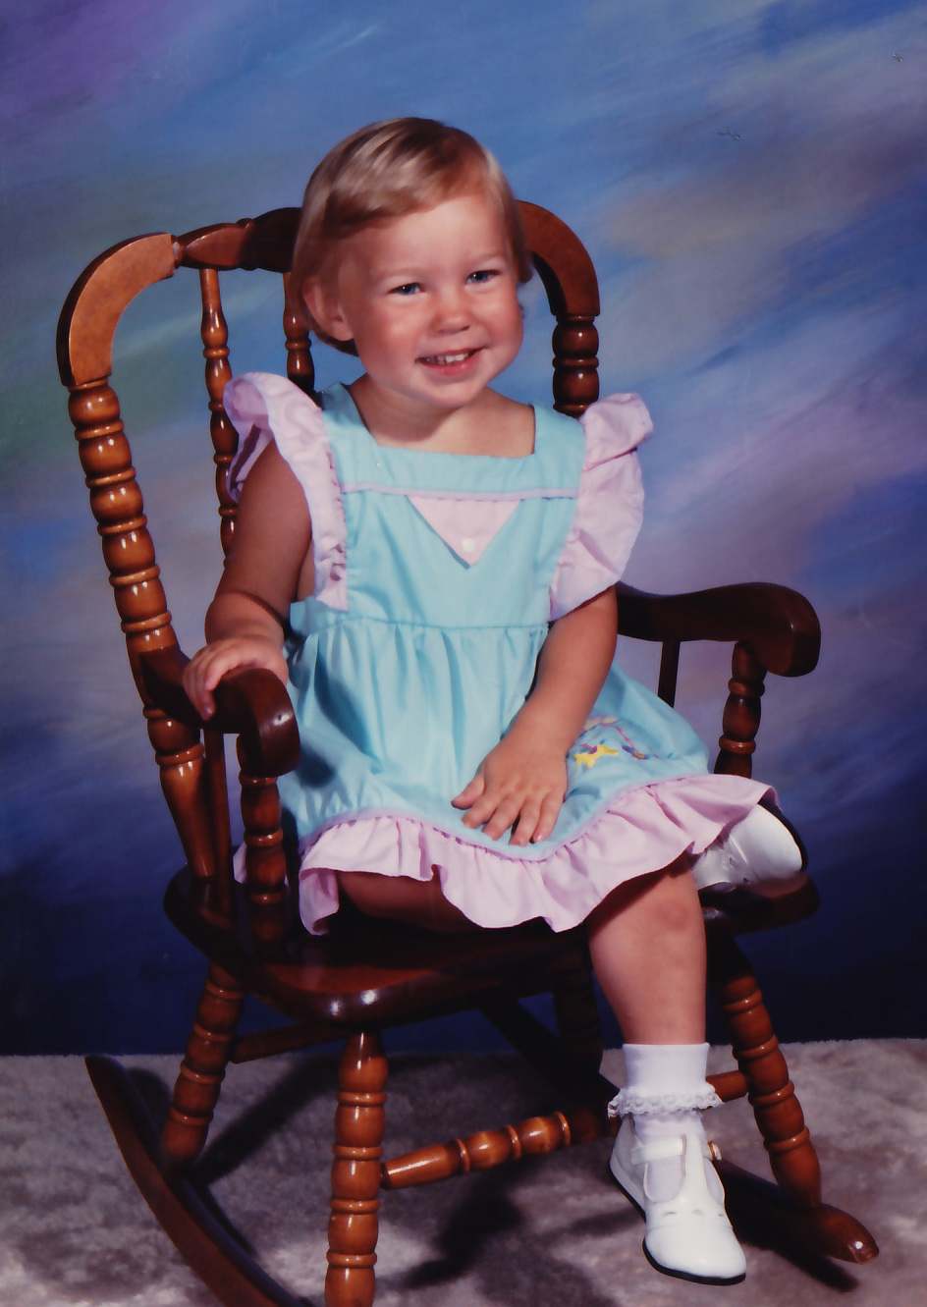
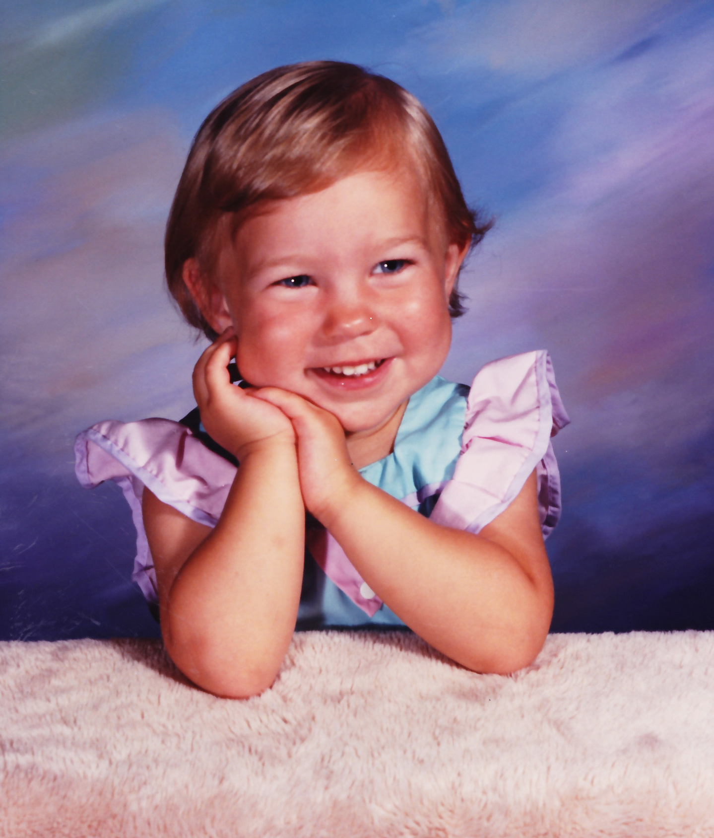

Slide 5
I have been doing this a long time.
This young lady now works for me. The pictures were taken more than 30 years ago by me or someone working for me.

Slide 6
I First did Preschools
And Child Care Centers
In the mid 70’s
They were being shot, but the photographers came from the K-12 and Youth Sports Market
I had a staff of several experienced children’s photographers
The competition didn’t have a chance

Slide 7
Within two years we were photographing more than half the preschools and child care centers in Colorado.
We were doing speculation packages.
Some of the schools did quite well but overall we were not making much.
I stepped away from this market for a few years.

Slide 8
Everything that follows is based on my personal experience, what has worked for me. You have different resources.

Slide 9
Ladies,
Women can do this, too
Check out my YouTube Channel
What I do might be much different than you think

Slide 10
Why Preschools
And Child Care Centers
First,
Why Not?

Slide 11
They are small, smaller than K-12 and youth sports
Children cry and they have boogers

Slide 12
They are Small
50 to 100 children may not seem like a lot but,
Higher sales per subject
Administration easier to work with
Relatively Easy to sell, schedule and please
No or few service items
They just want to sell pictures and make parents happy (Tammy, Southeast Tech)

Slide 13
Children Cry and, Well ---
That’s a good thing, anything that gives you an easy chance to look good and be a hero
Learn how to wipe noses, Child Care staff usually aren’t very good at it

Slide 14
Different Programs
Prepay
Proofs, either paper or online
Speculation packages

Slide 15
What are Speculation Packages?
And
Why do them

Slide 16
What
Photograph every child and sibling group
Print a package of prints for every child and sibling group
Send the pictures back to the school for the school to sell.
Collect the payments from the school.

Slide 17
Why Spec Packs
Higher sitting volume and total sales per school
Simple production with lower costs
Finished packages in the parents hands more quickly, No delivery problems
No objections about pose or print quality
Your lab will love you
Fewer problems with schools and parents
Parents love it!!!!

Slide 18
Perils of Speculation
School makes little or no effort to show and sell the pictures
Pictures sent home and not paid or returned

Slide 19
What we do

Slide 20
Only Photograph
Good-looking, Well-behaved Children
Sometimes I will explain it to them right up front.

Slide 21
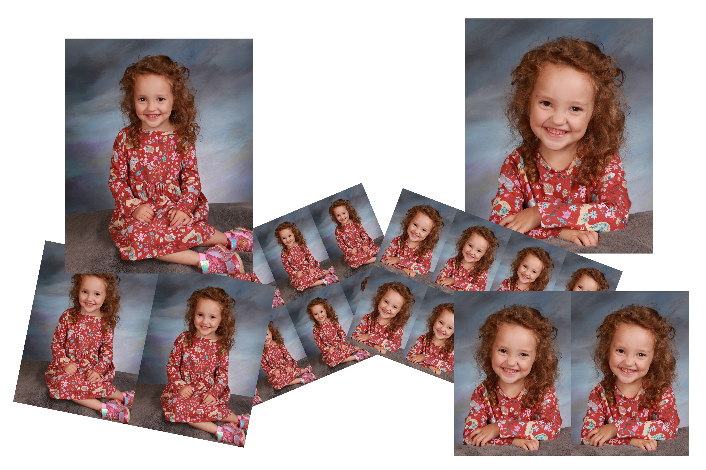

Slide 22
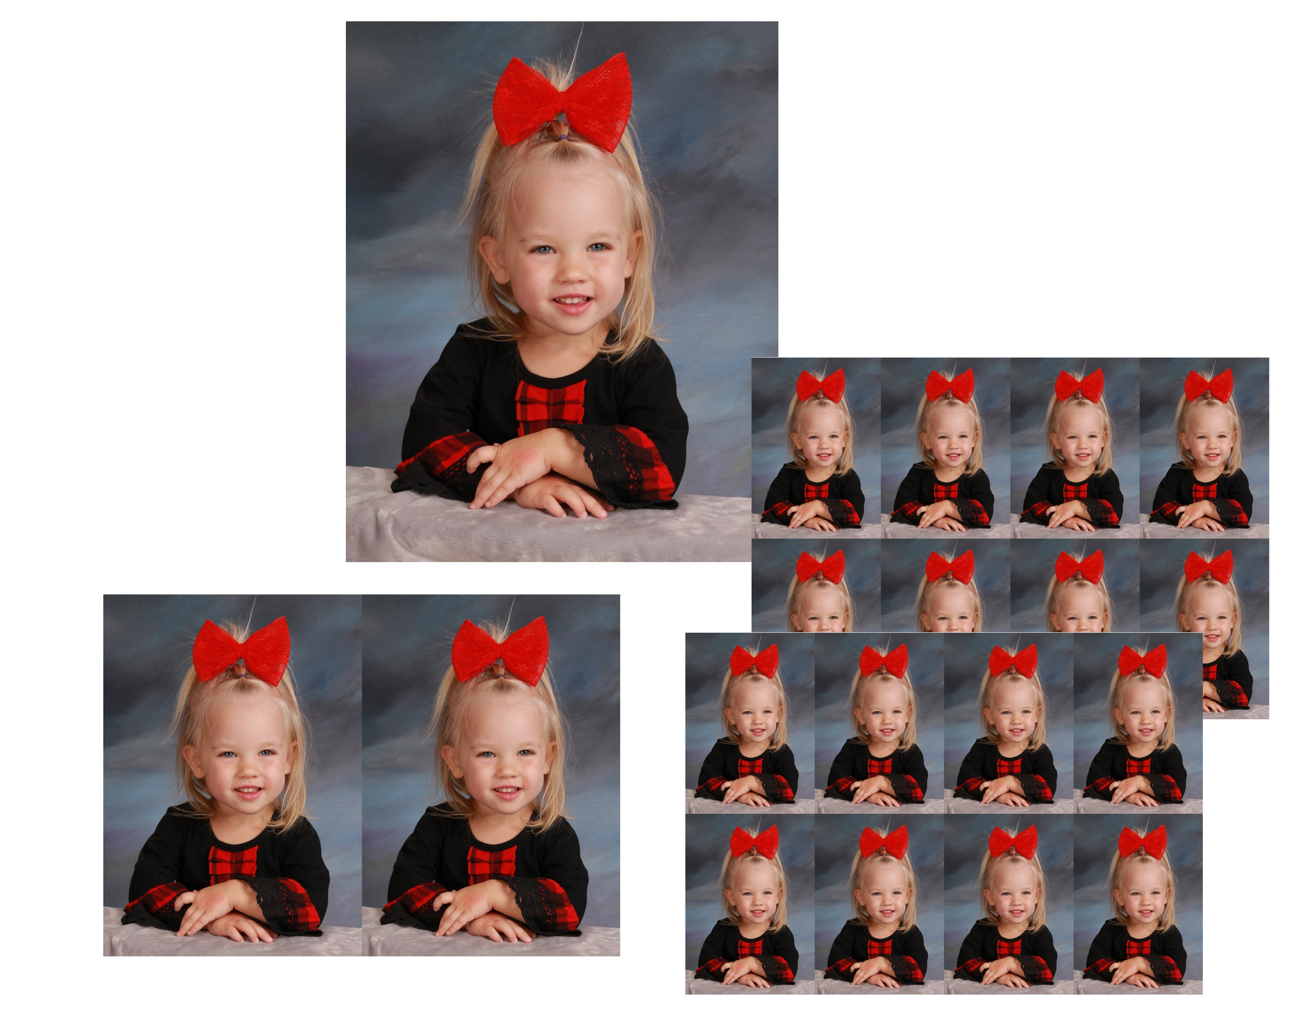

Slide 23
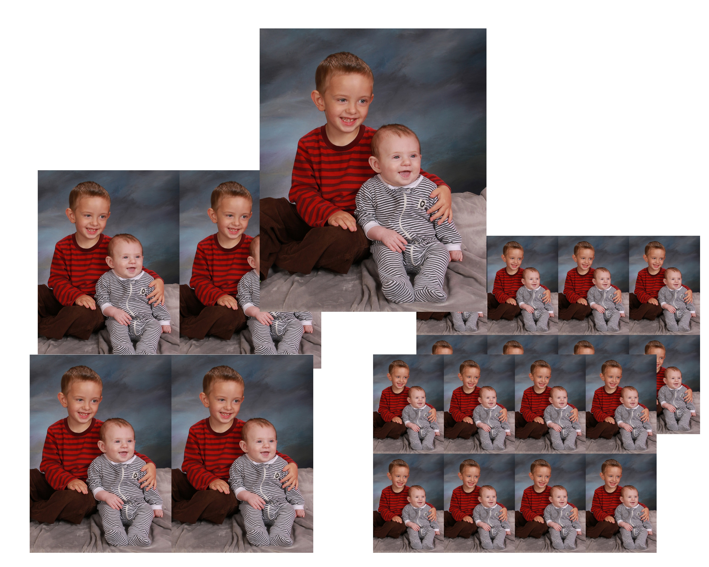

Slide 24
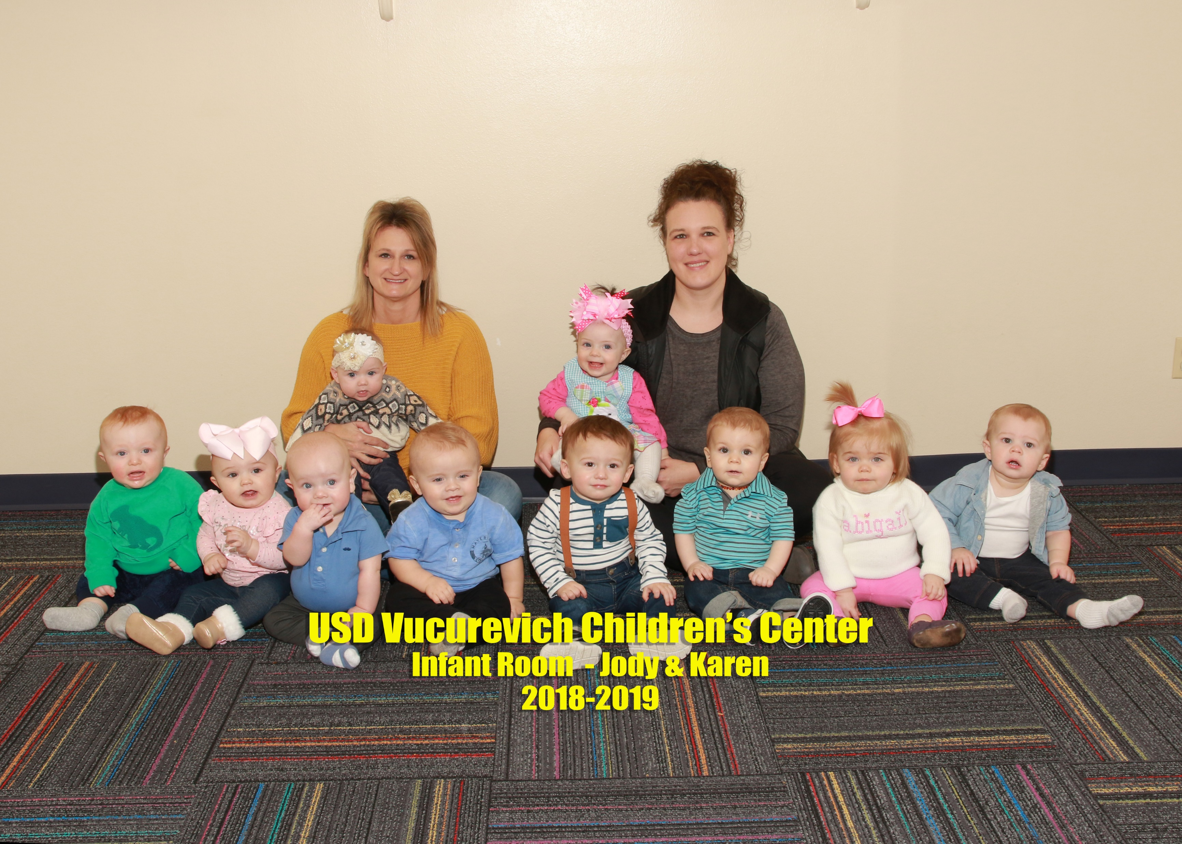
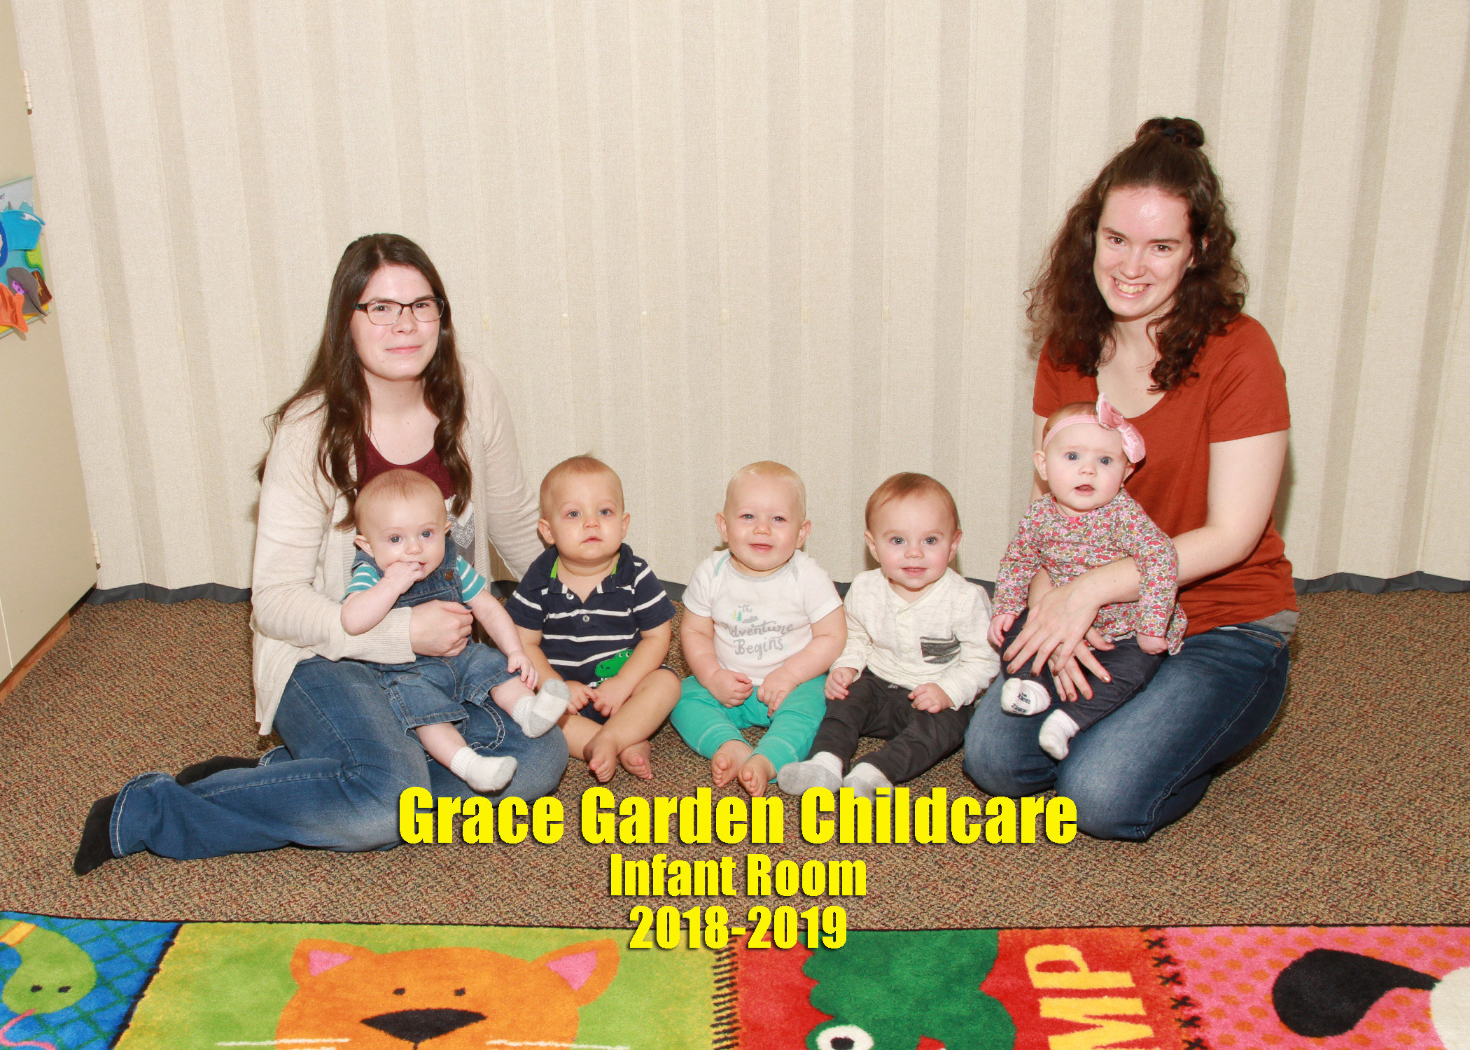

Slide 26
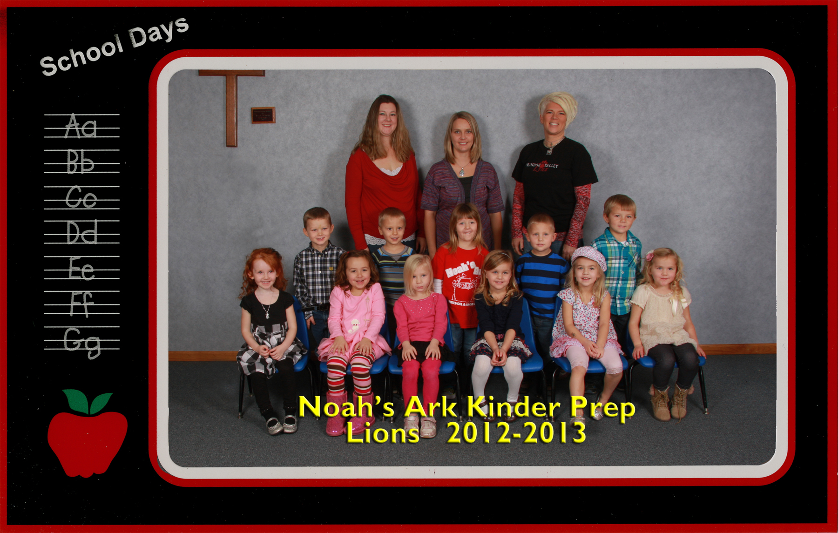

Slide 27
Model Releases
Pick 3 or 4 subjects from each school
Use them on the posters for the next session in that school
Offer them something that you don’t normally sell, we give them a poster

Slide 29
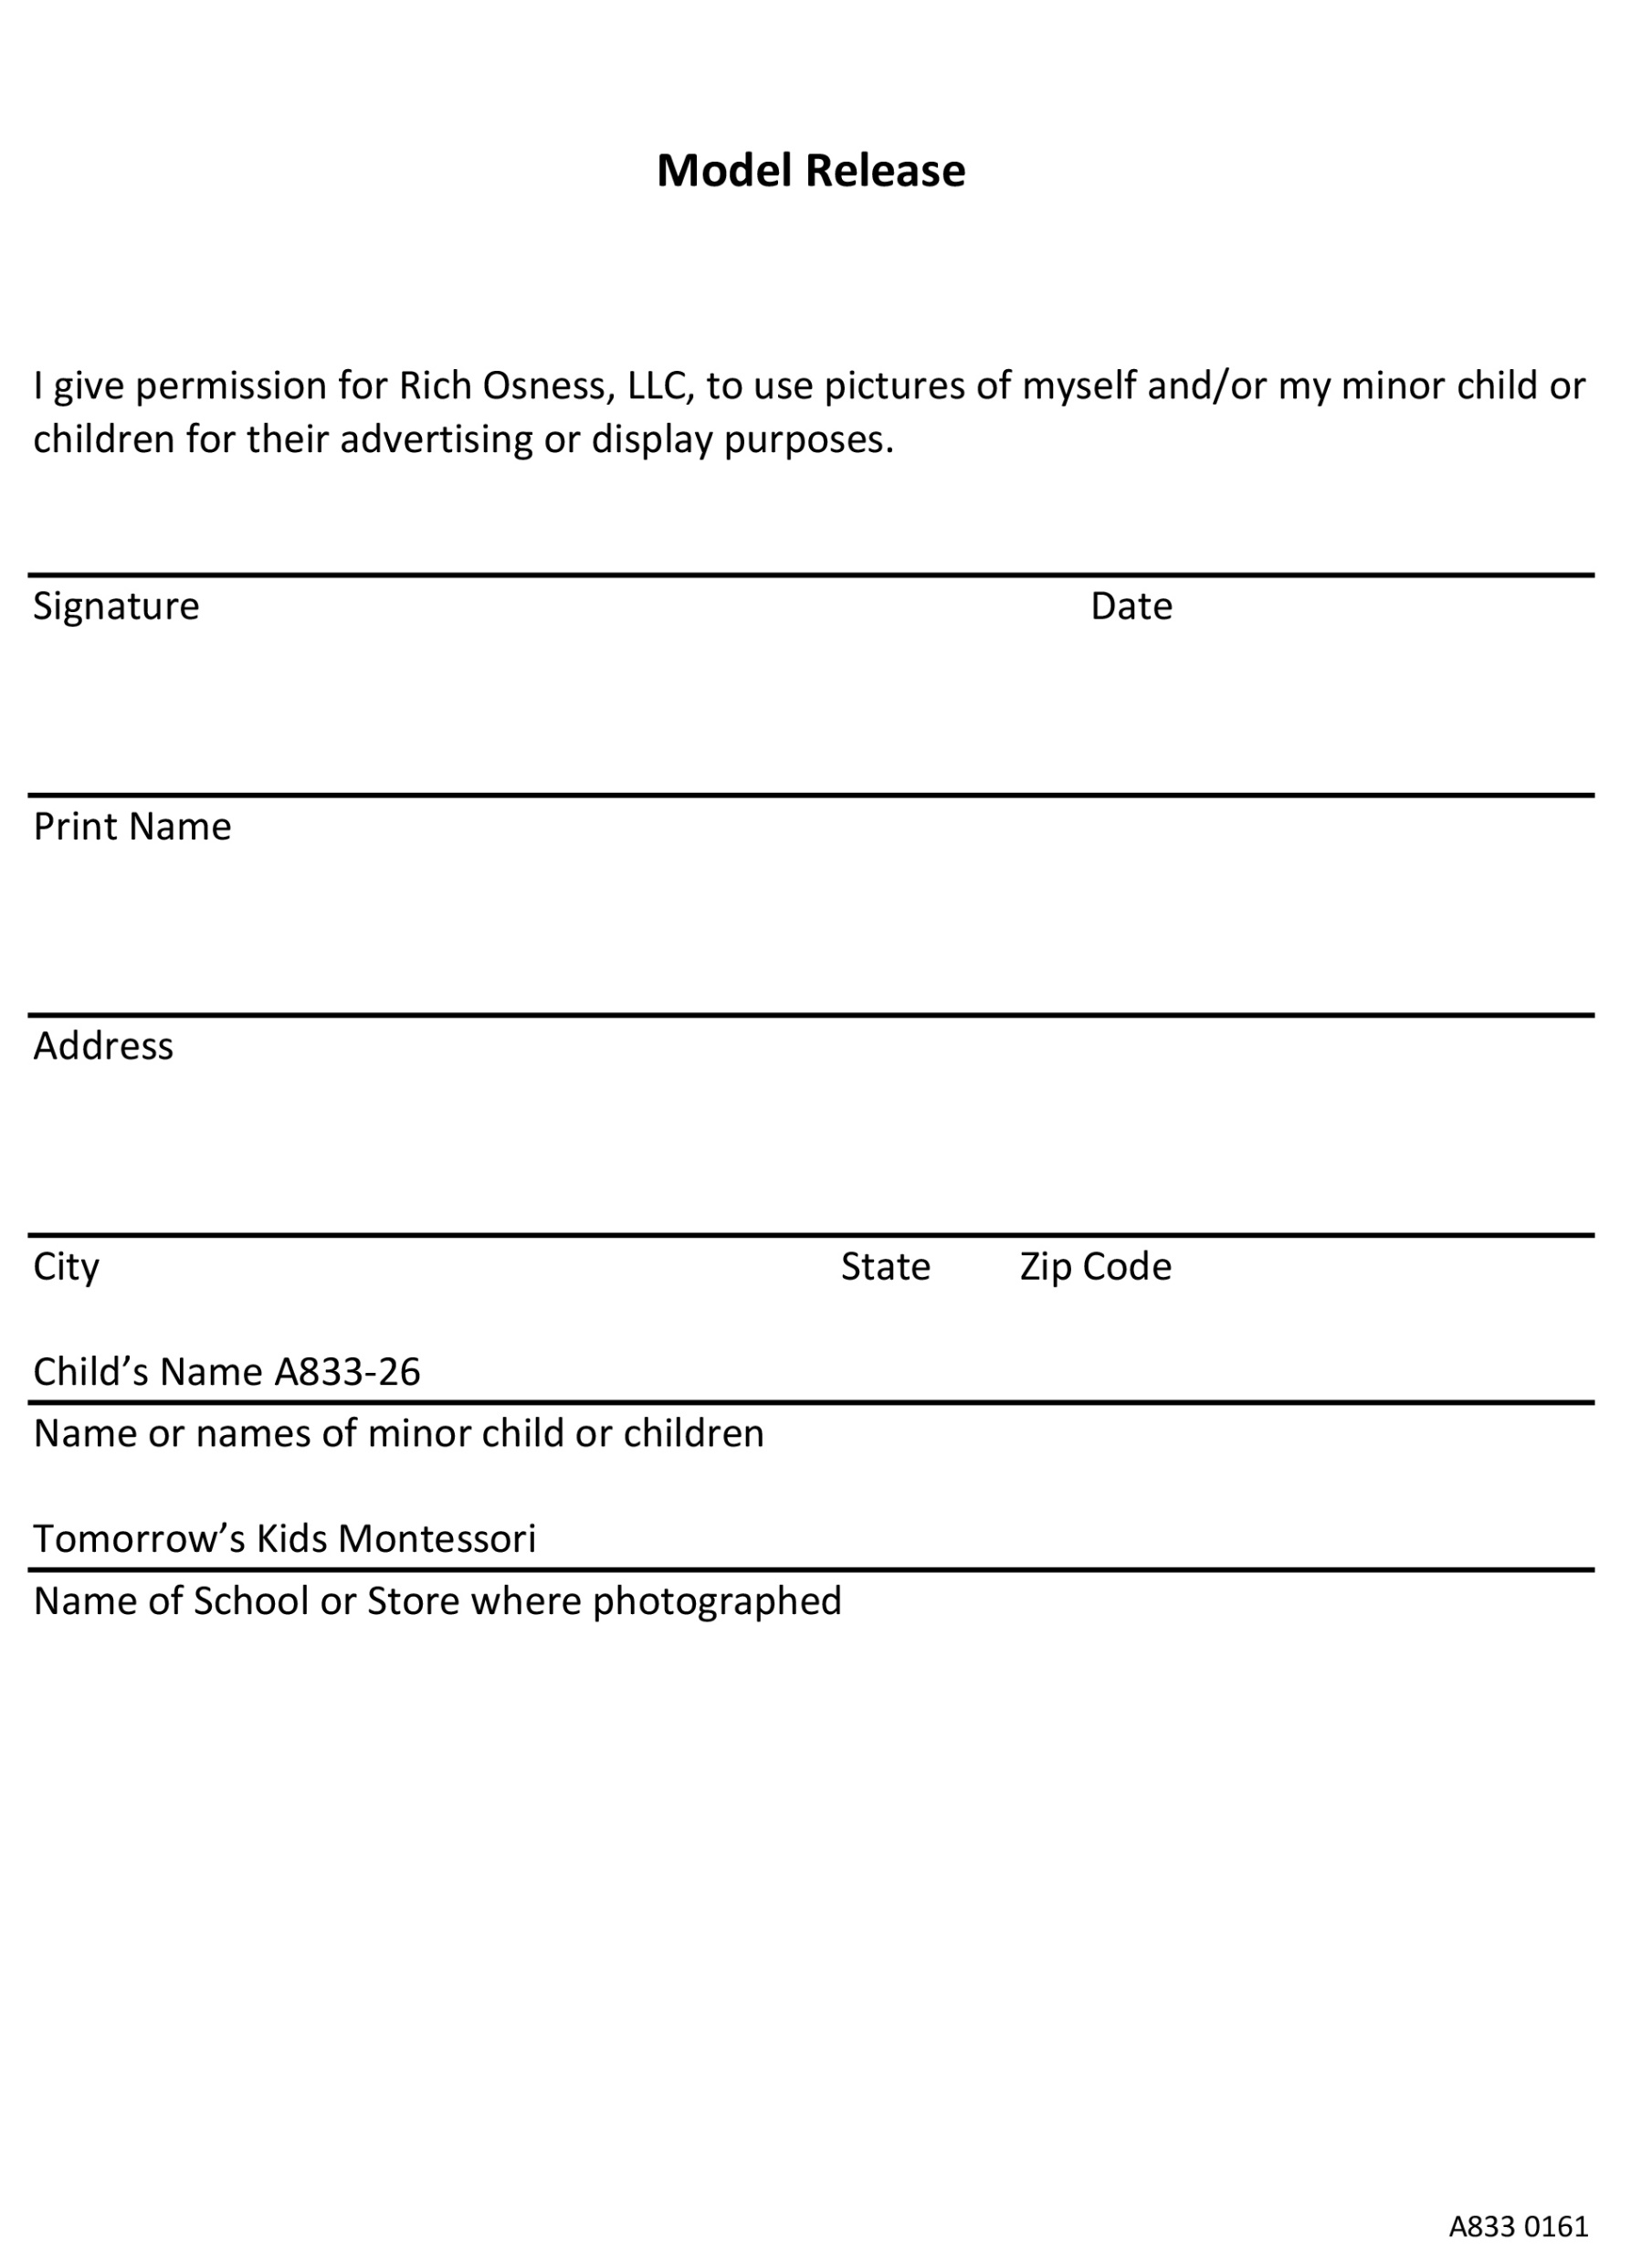

Slide 30
Other Poses We Do

Slide 31
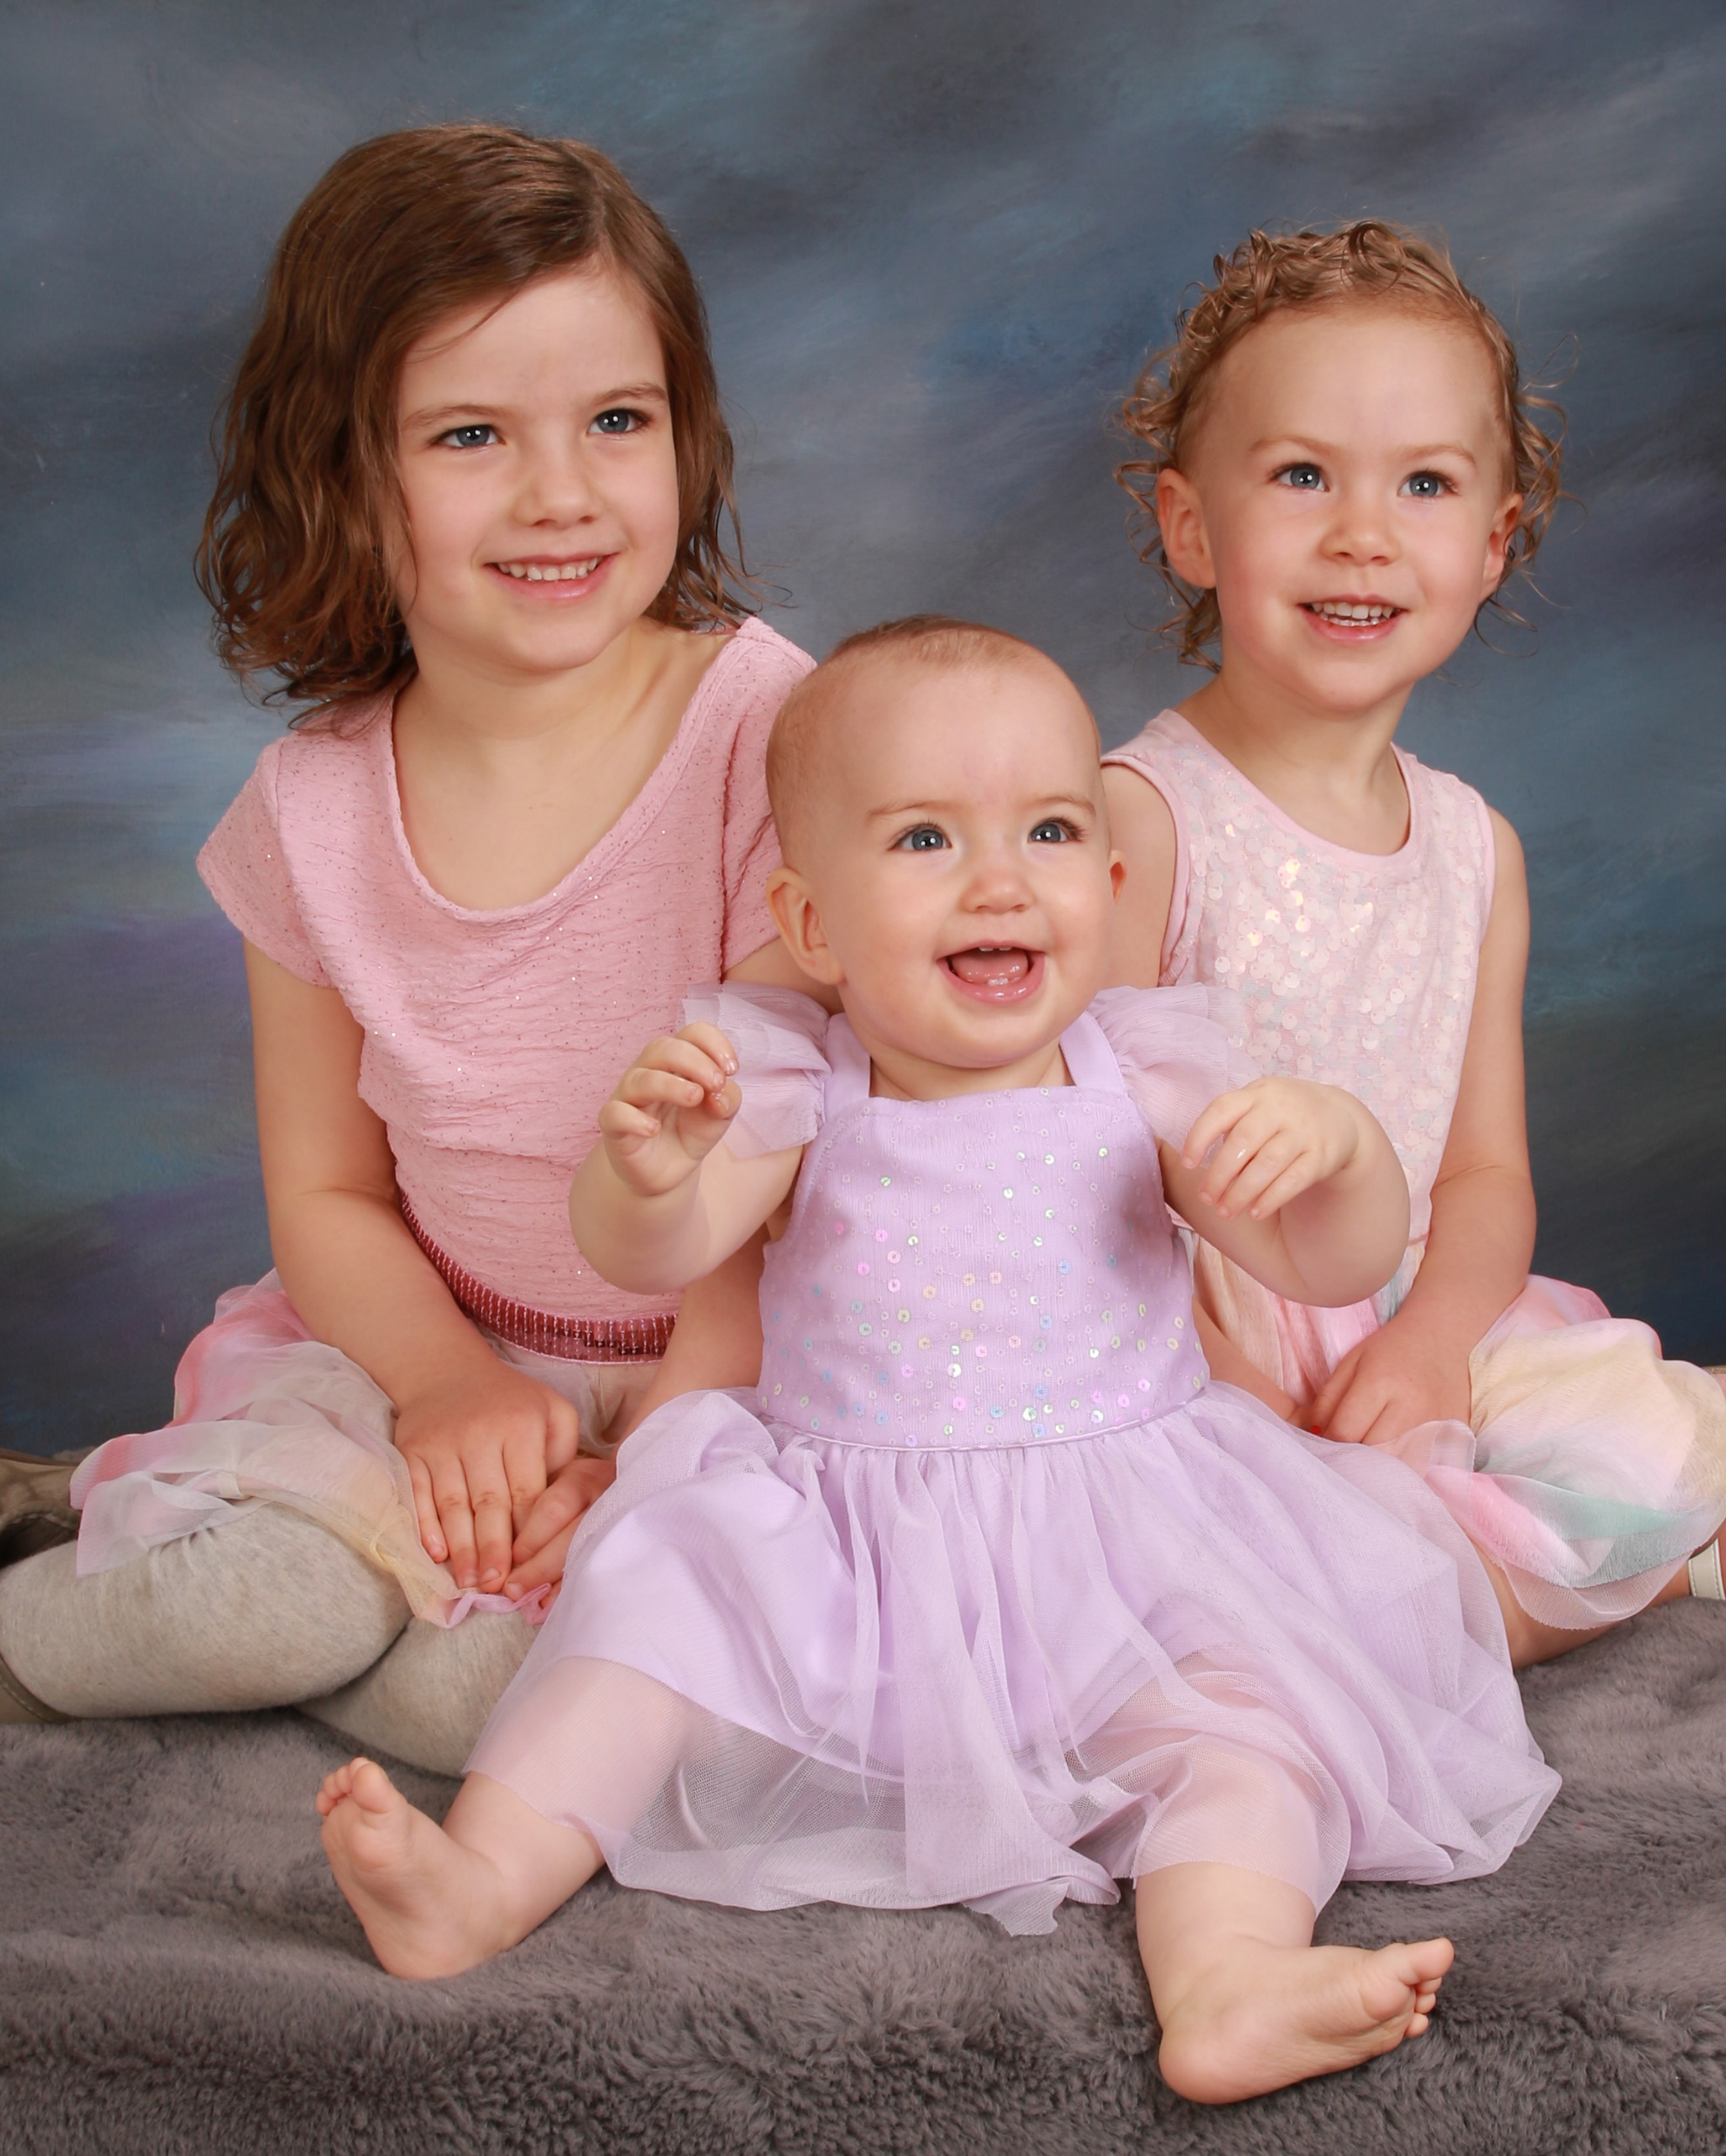
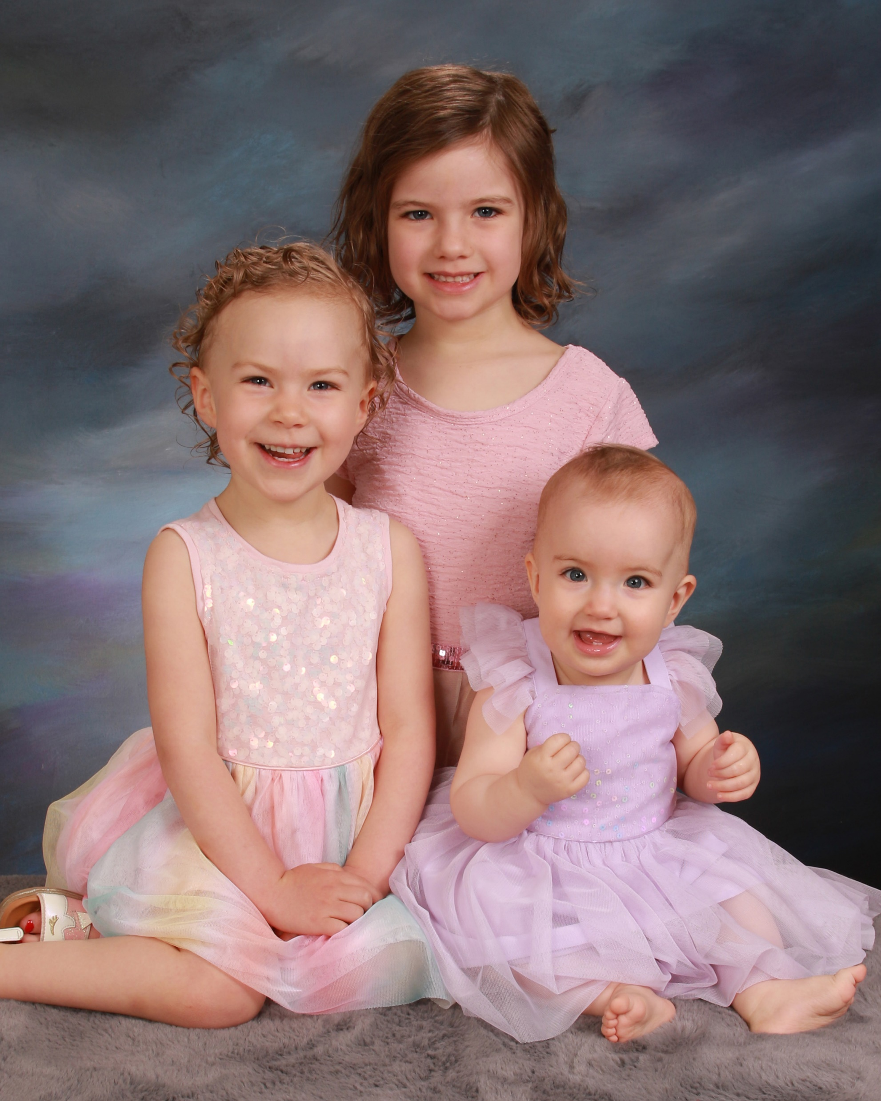

Slide 32
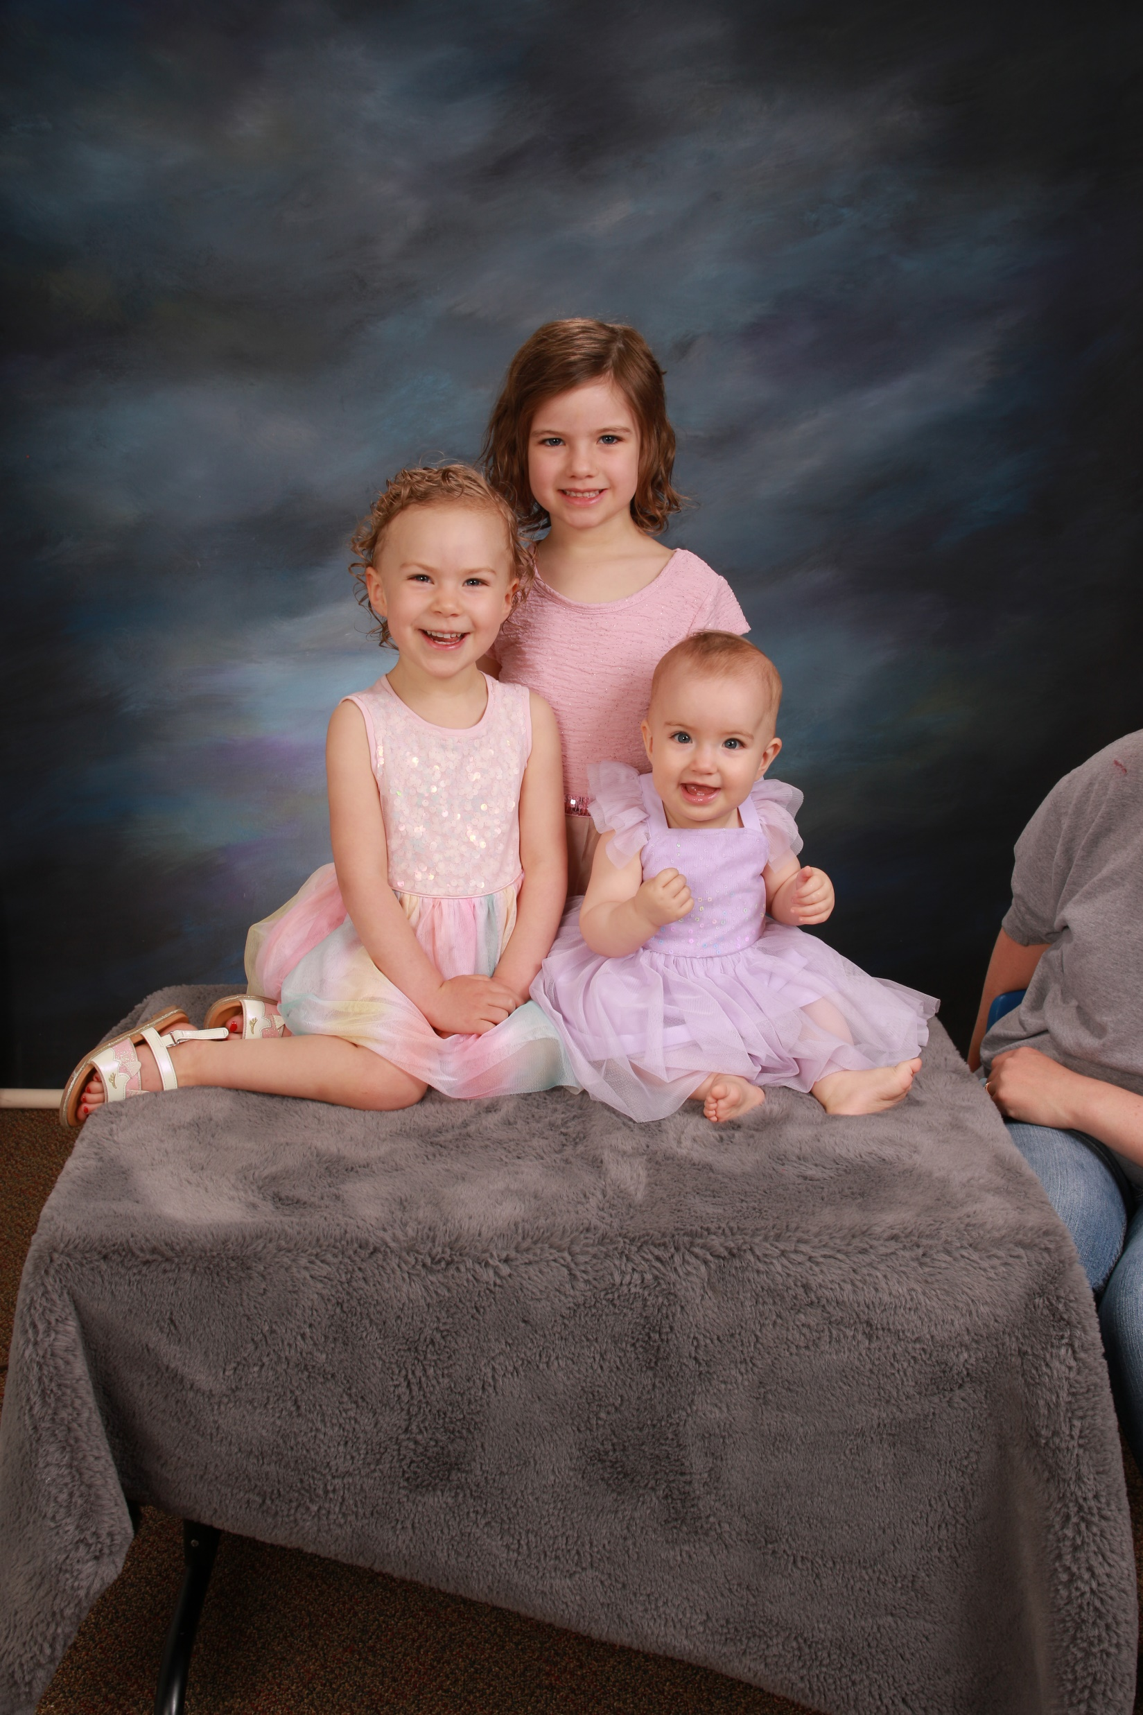
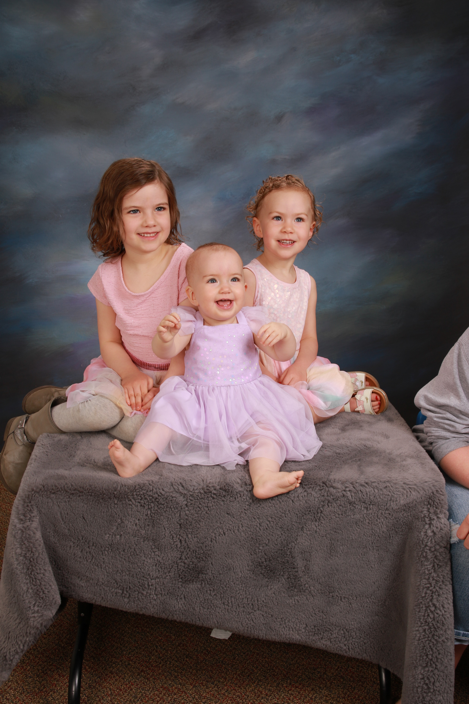

Slide 33
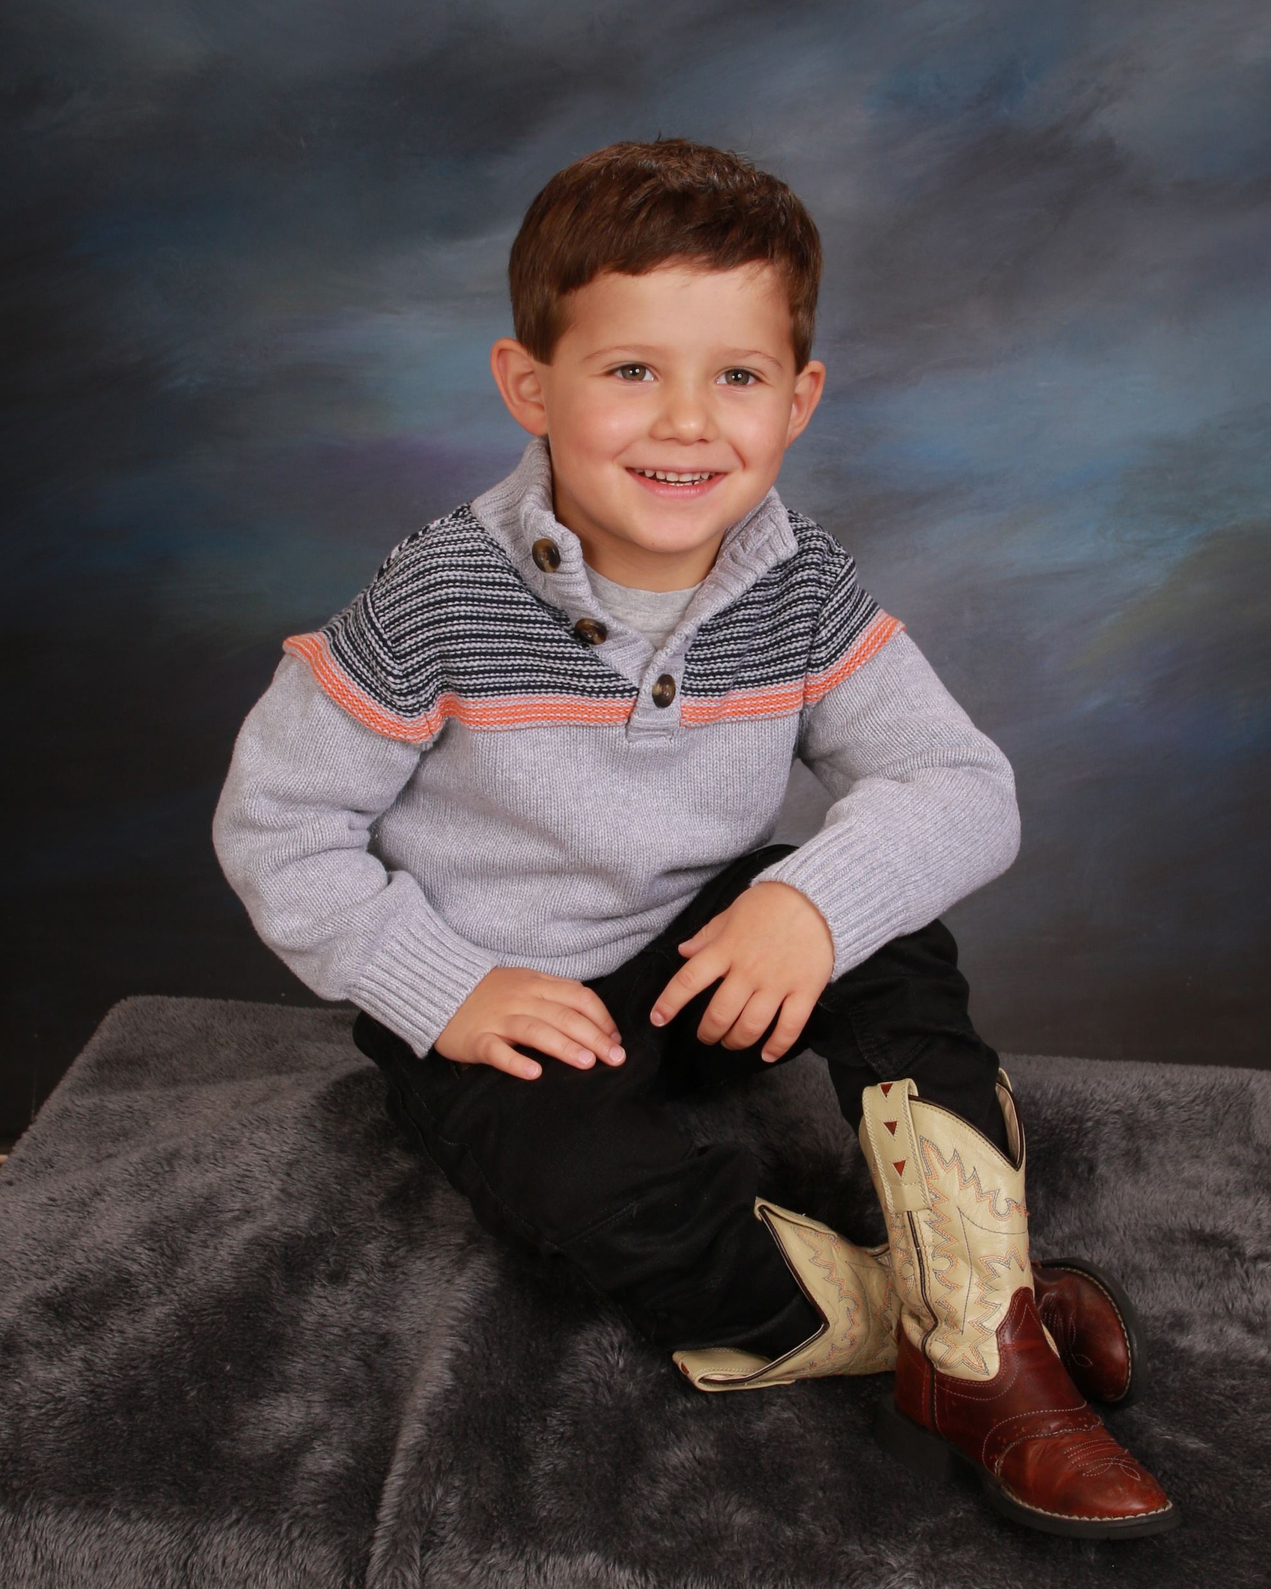
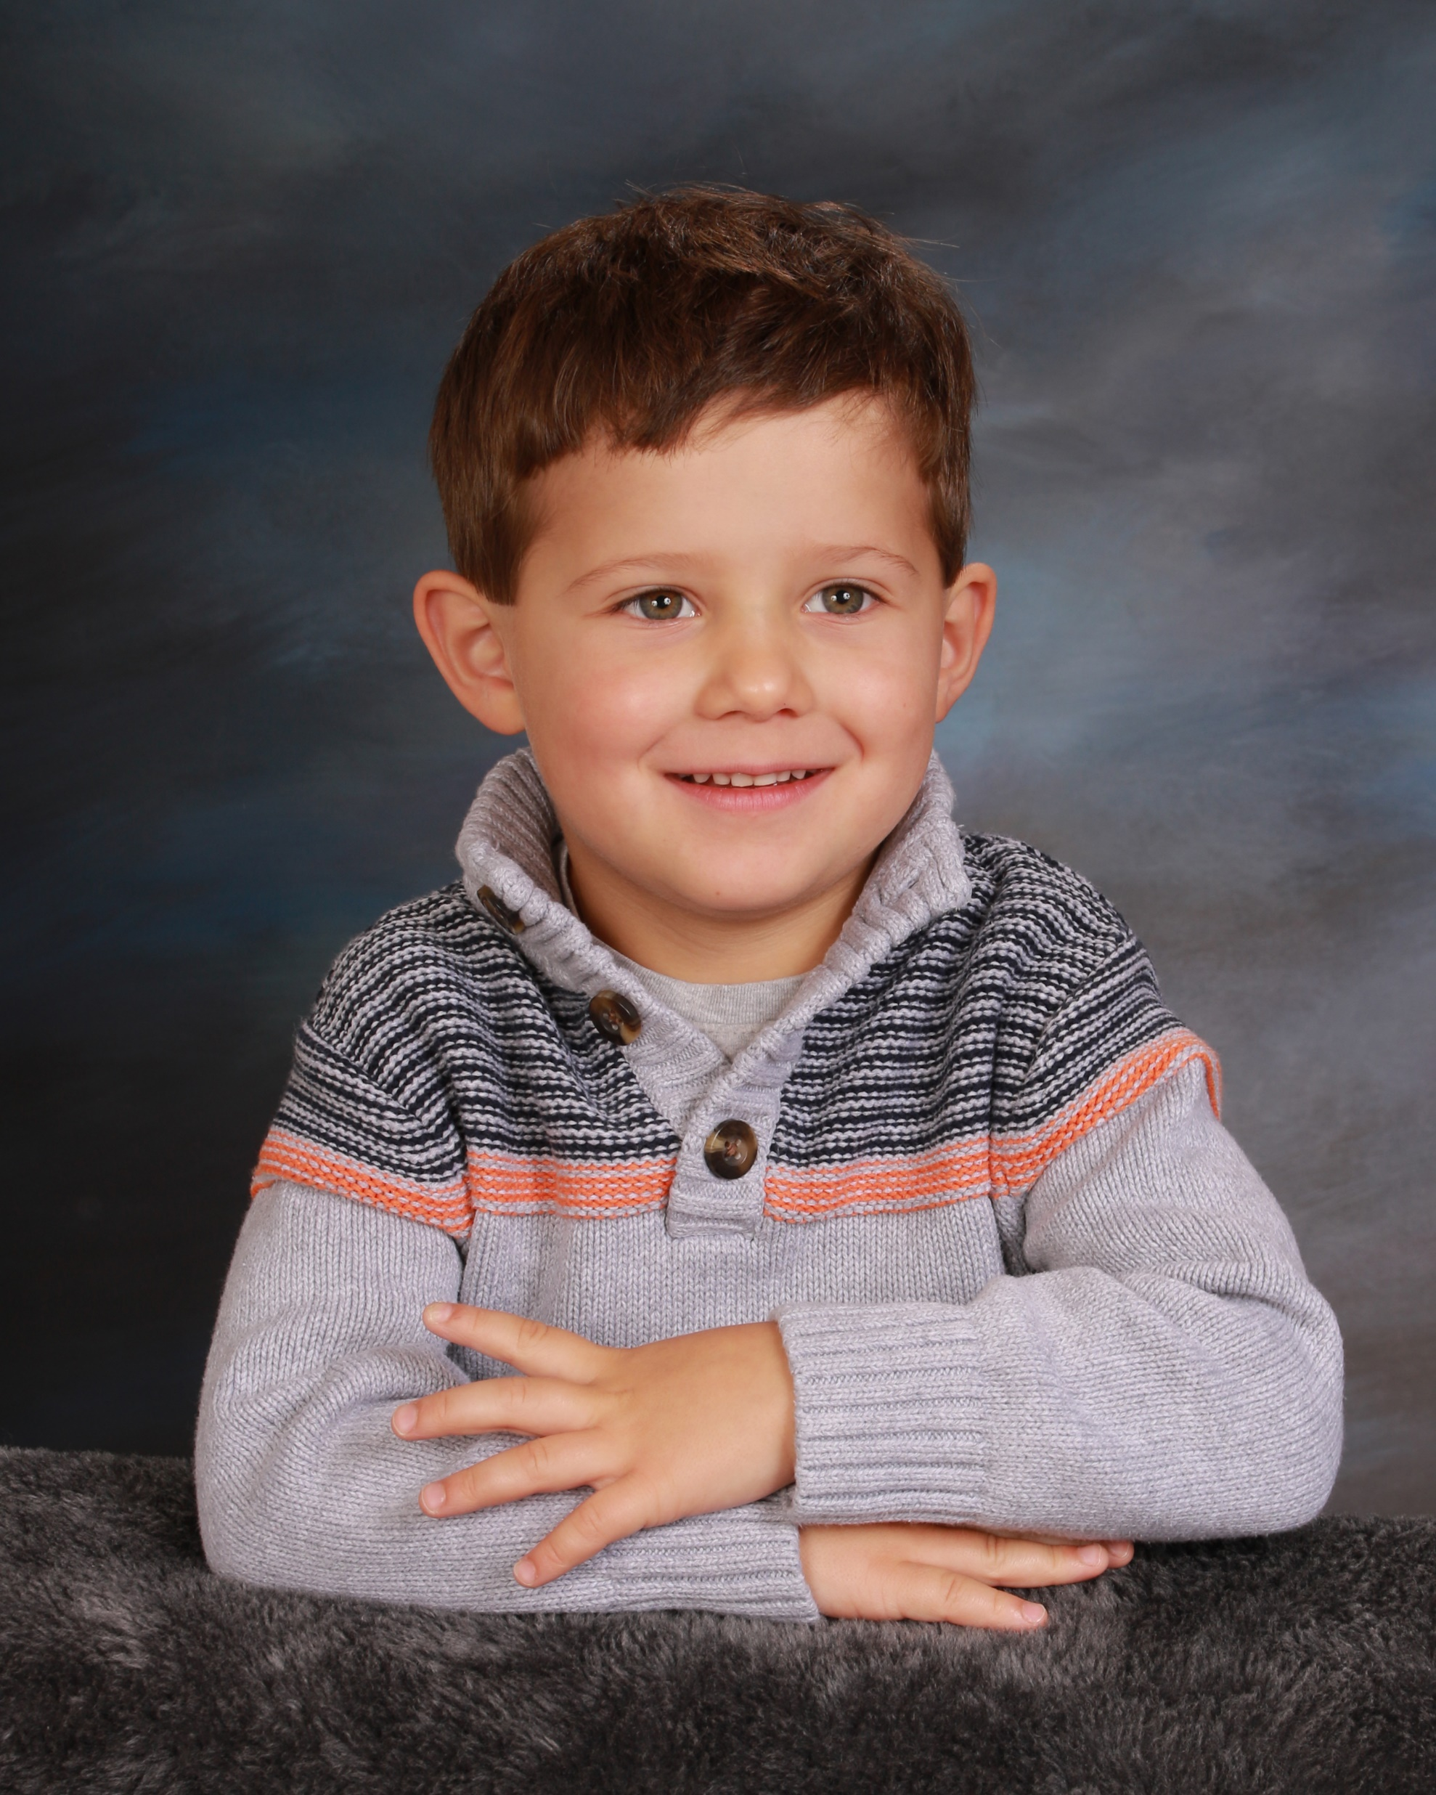

Slide 34
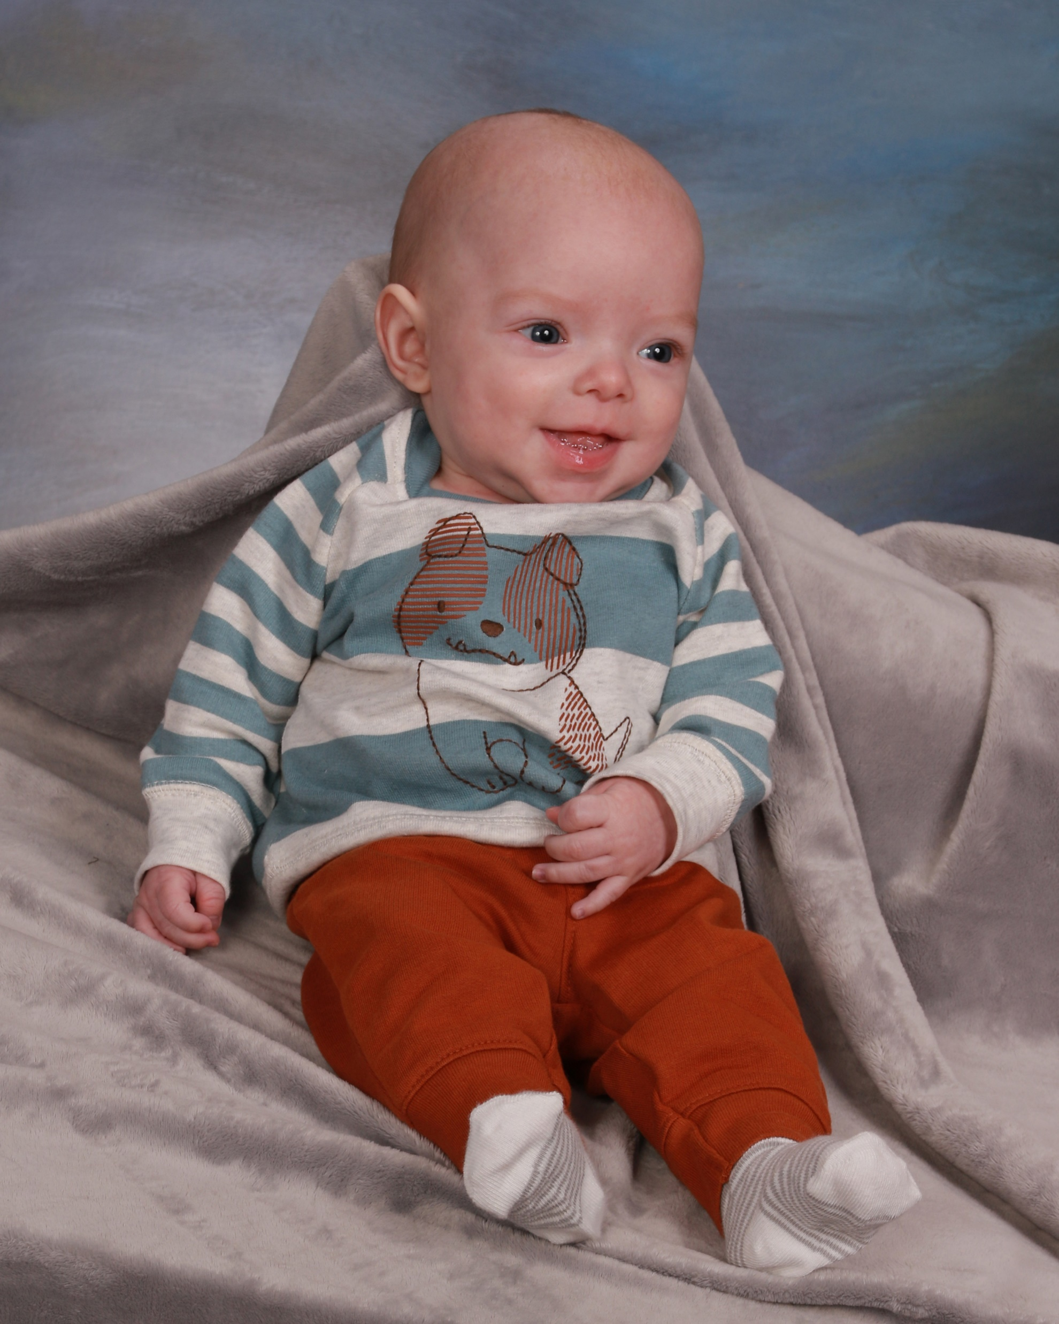
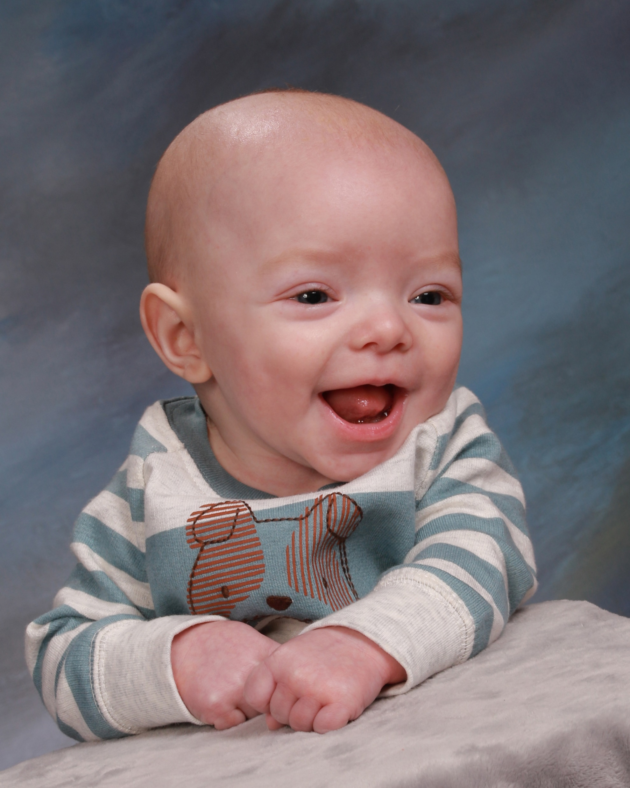

Slide 35
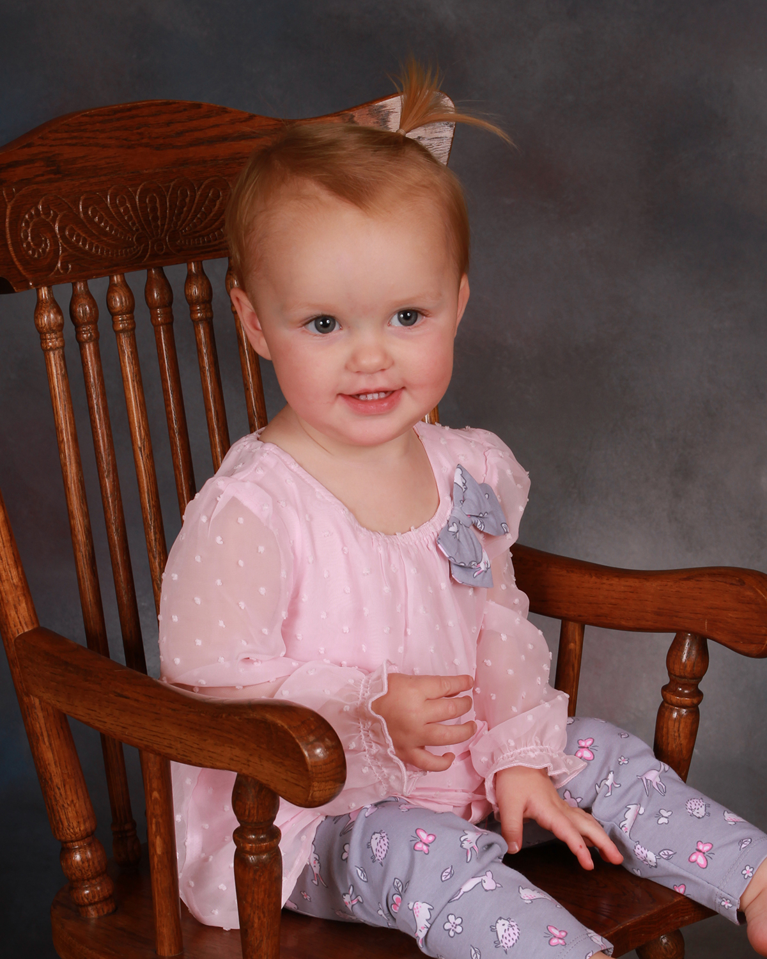
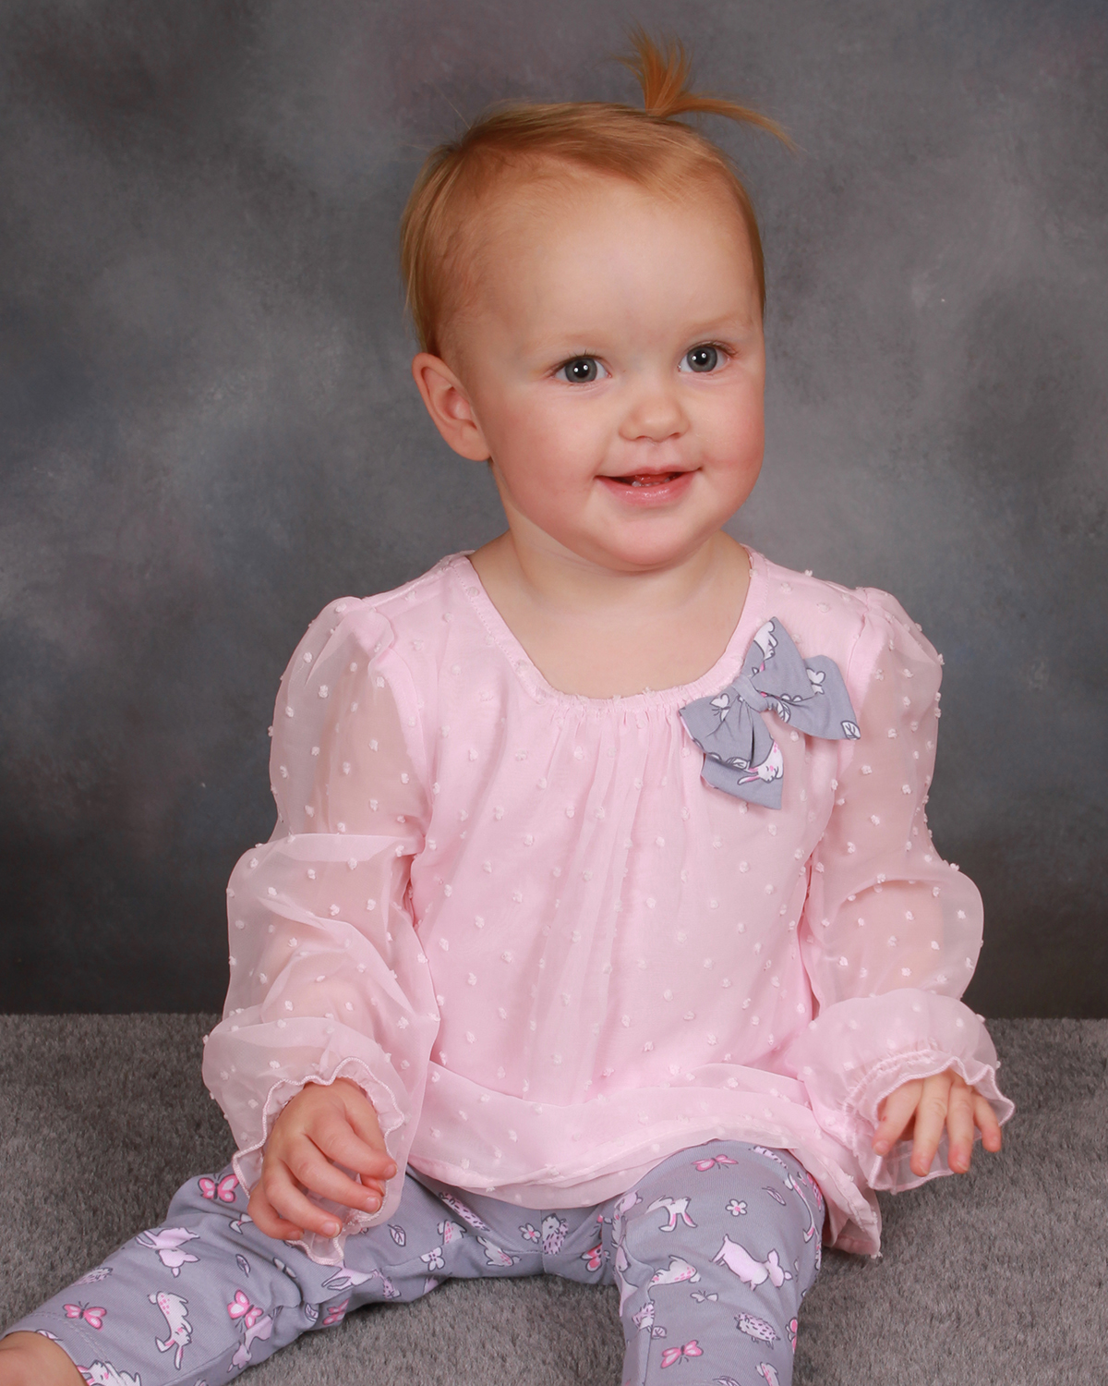

Slide 36
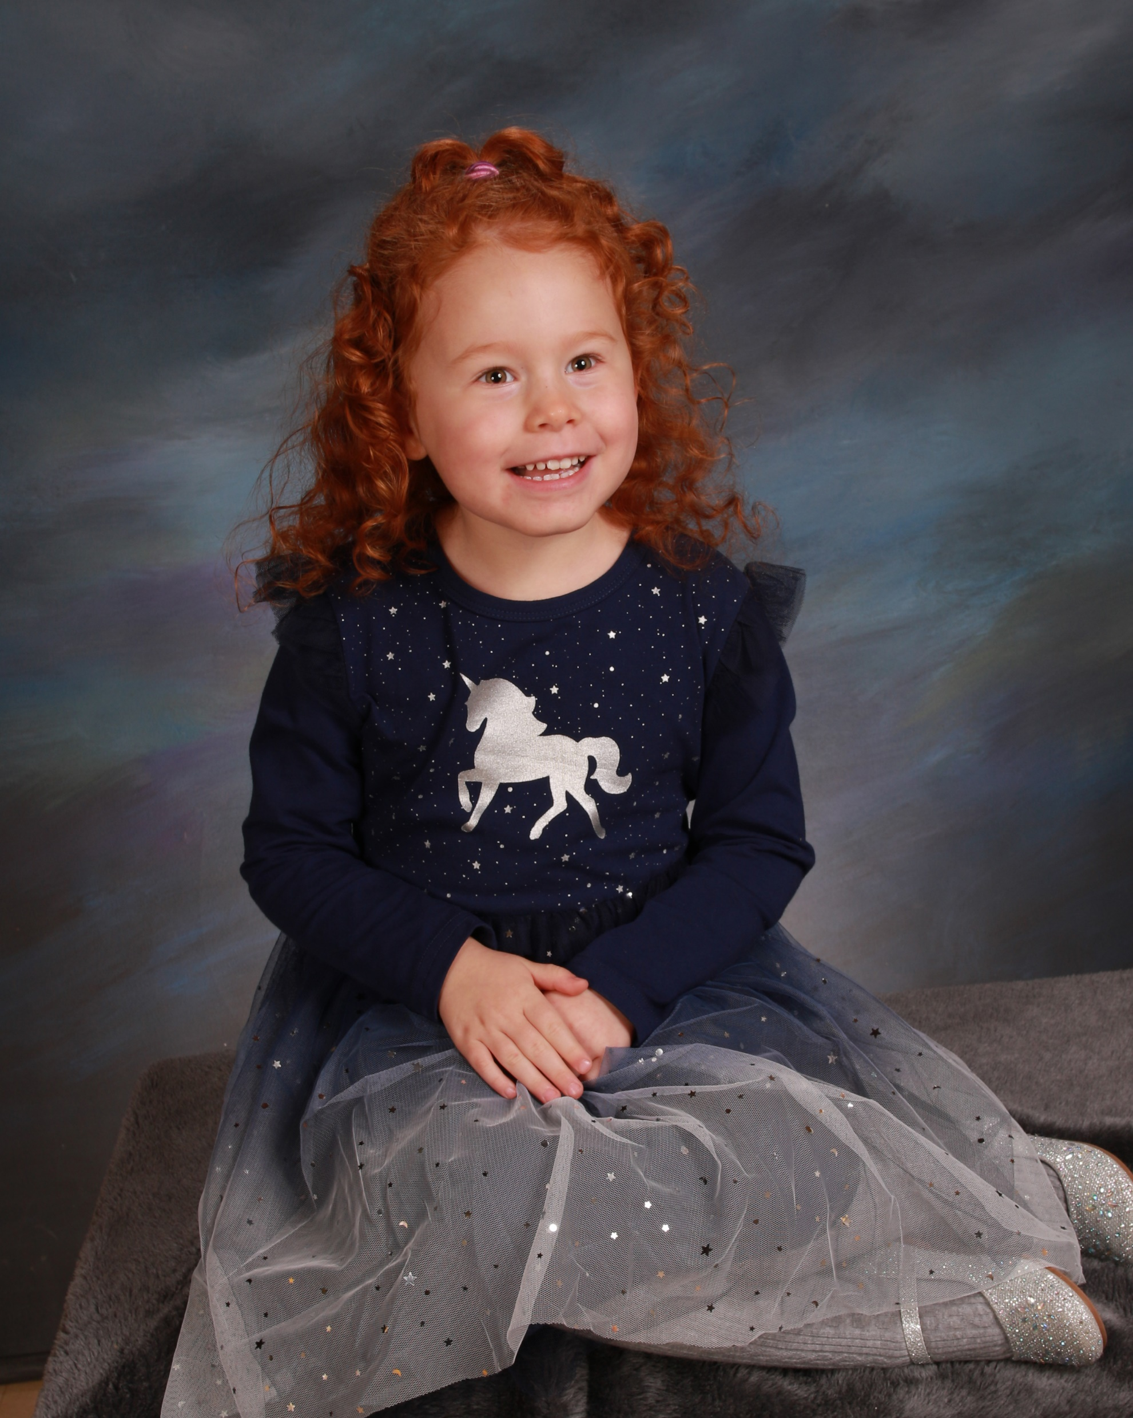
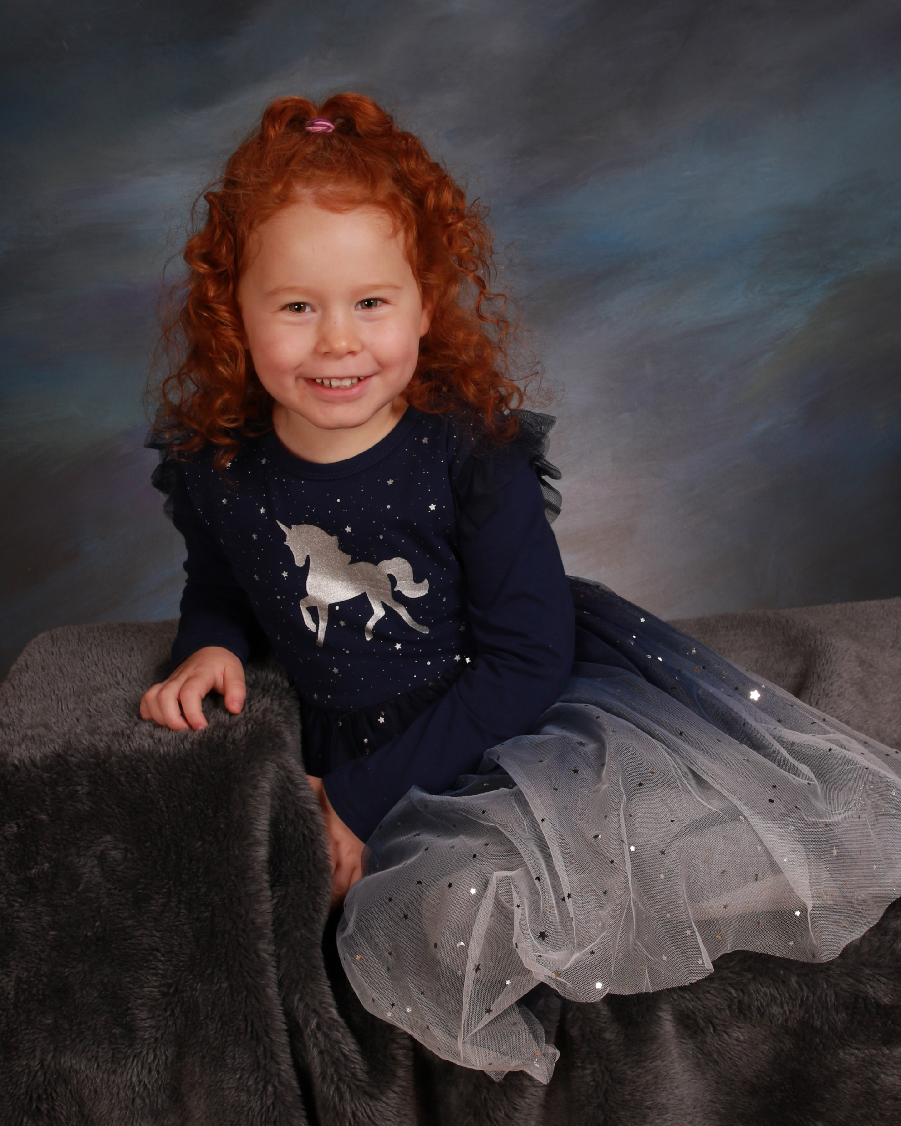

Slide 37
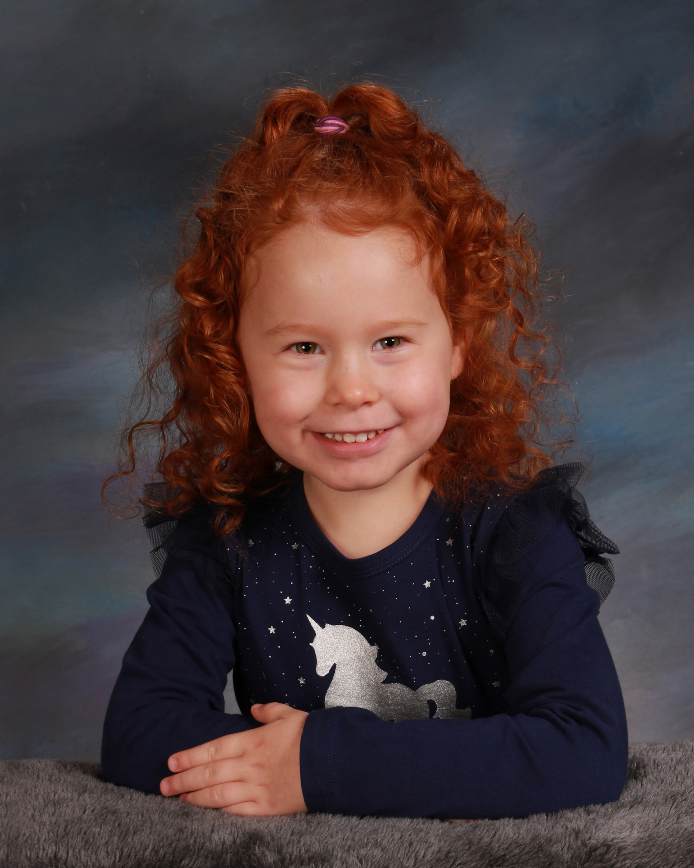
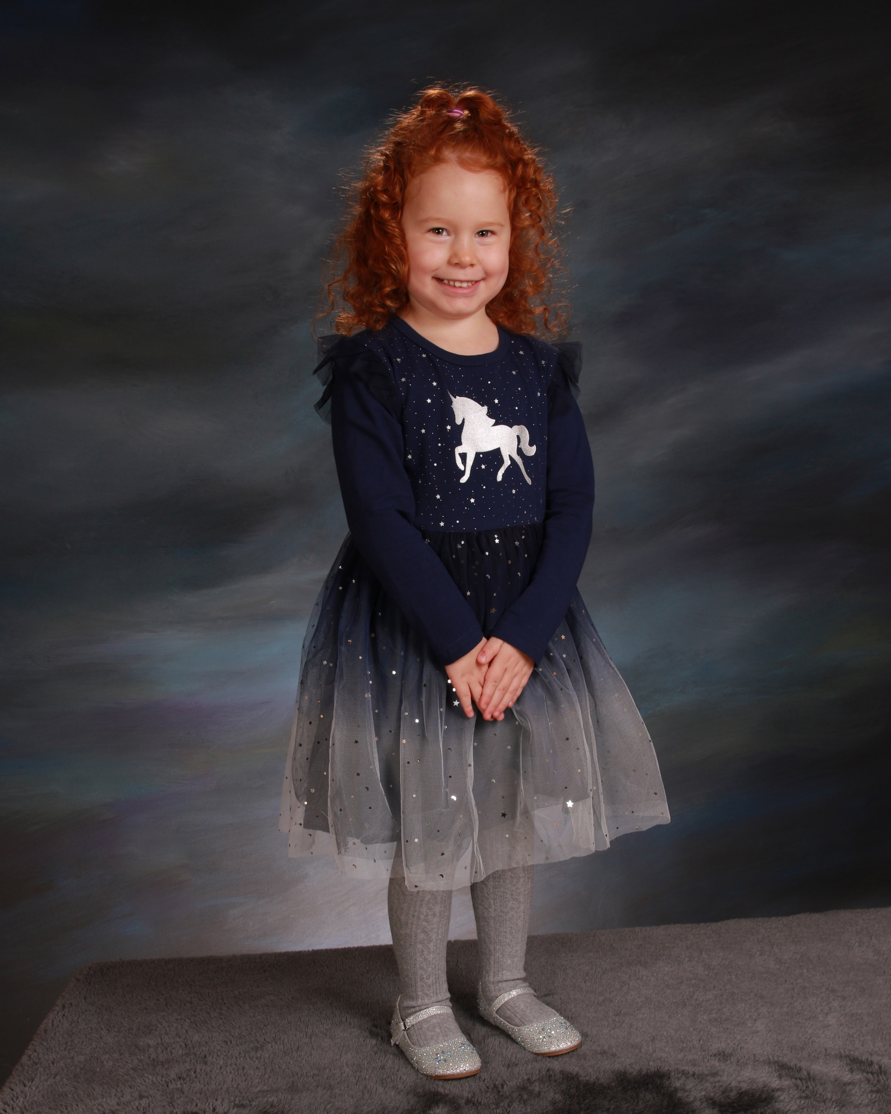

Slide 39
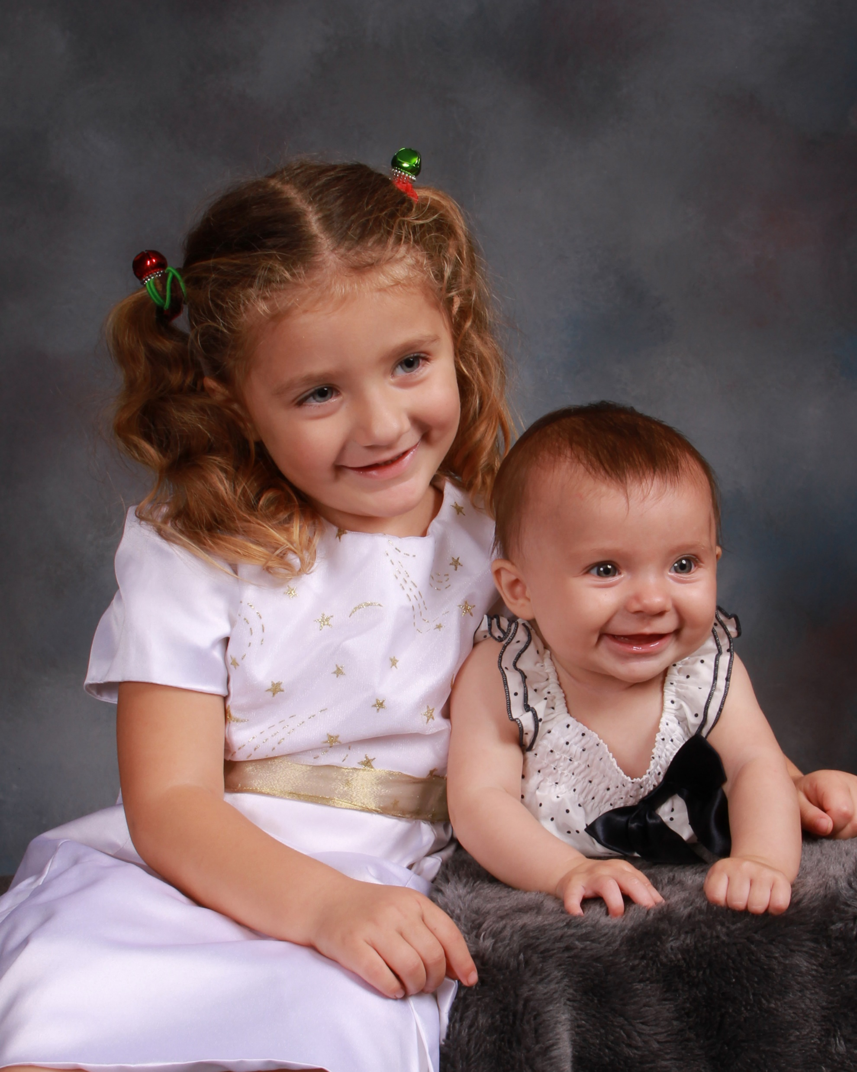
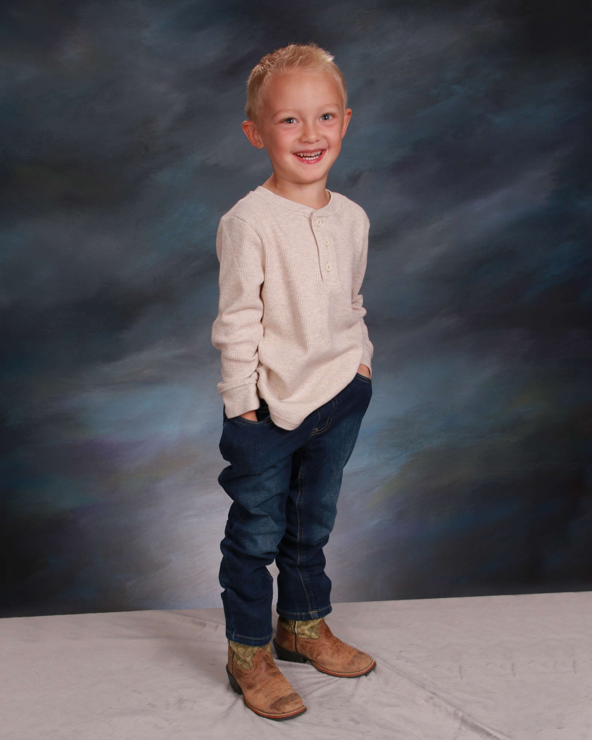

Slide 40
Your pictures don’t have to look like this to sell.
Better pictures have a greater effect on account retention than on sales.

Slide 41
Booking and Scheduling
Which Preschools and Child Care Centers
To Book
(There are some you don’t want to book)

Slide 42
Church Affiliated
College or University Affiliated
Private owner-operated
Small Chains
Large Chains
Who will be selling your pictures

Slide 43
How to Book
Phone
Direct Mail
In Person Cold Calls

Slide 44
Cold Calling
Research to select prospects
Knock on doors to introduce yourself and find out who really makes the decision
Be prepared to pitch or set up a good time to stop back
Show packages!!!!
Have leave behind materials

Slide 45
Always be ready to get a signature and give a date
Multiple Days-Know what you can do and be prepared to commit
Don’t let them ask parents if they want pictures

Slide 46
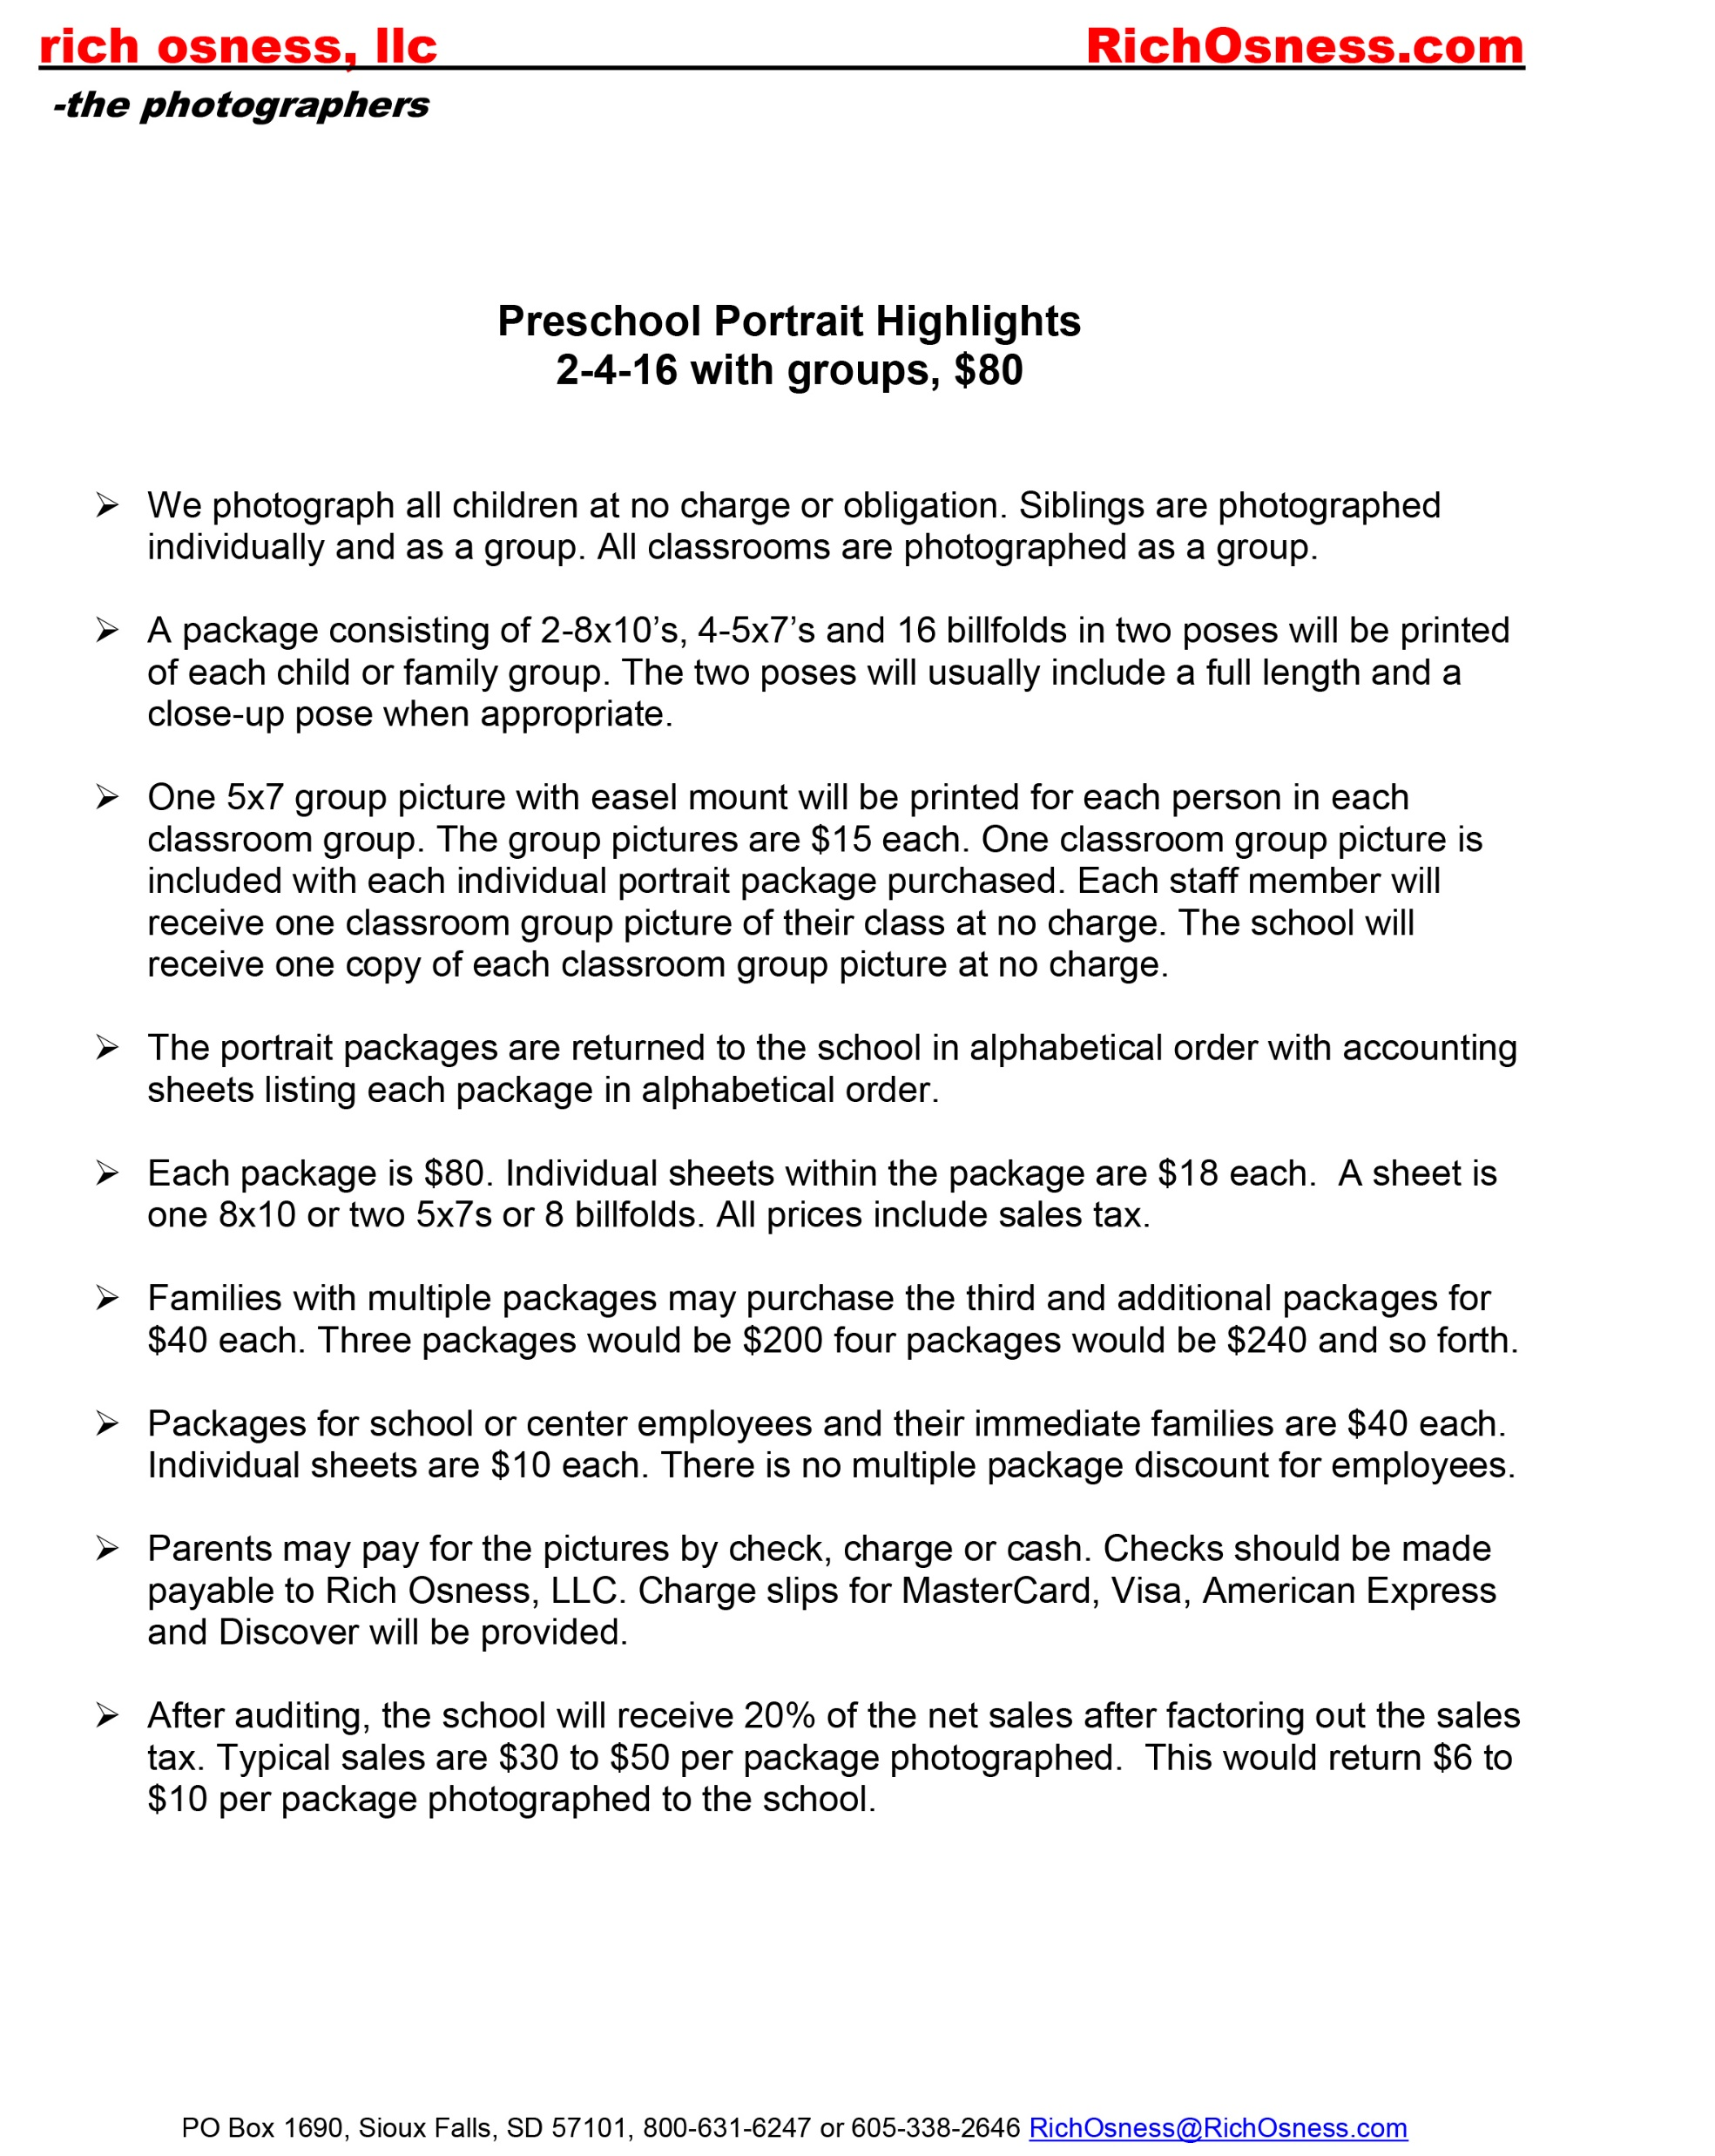

Slide 48
What we do for the schools

Slide 49
Usually
20% of net sales
Discount for all staff on pictures of their children
Free class pictures for staff and school
Sometimes
Staff packages at no charge, two sheets in one pose, digital files, run them through Portrait Pro
Half sheet of sub-wallets
Staff Badges or ID Cards
All school group or composite
Discounted prices with no commission
Gift card instead of check for their commission

Slide 50
In-school
Promotional Materials
Opt Out
NOT
Opt In

Slide 52
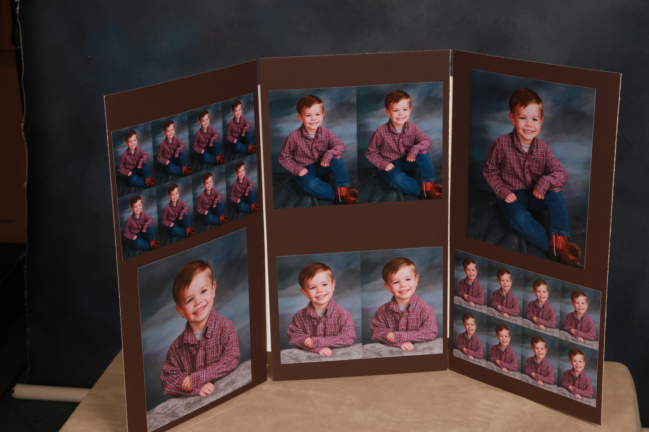
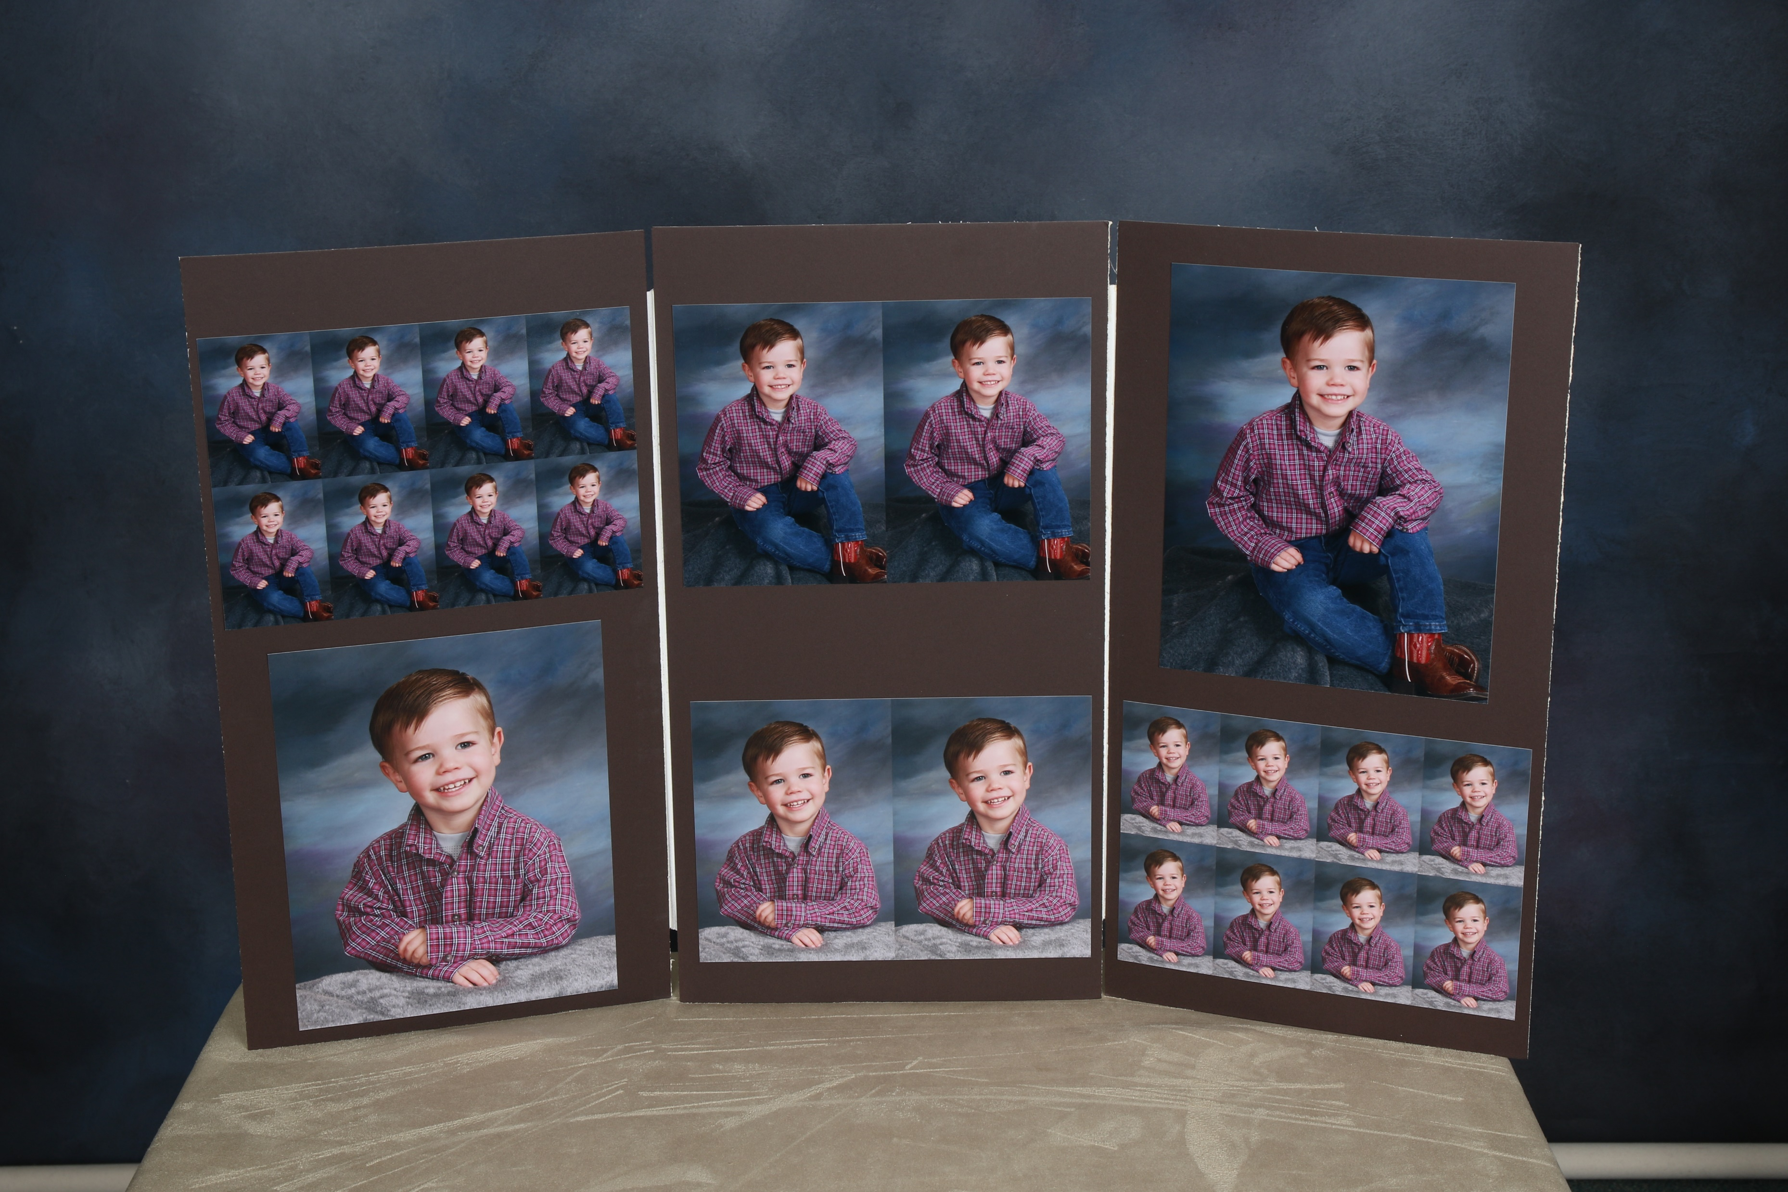

Slide 53
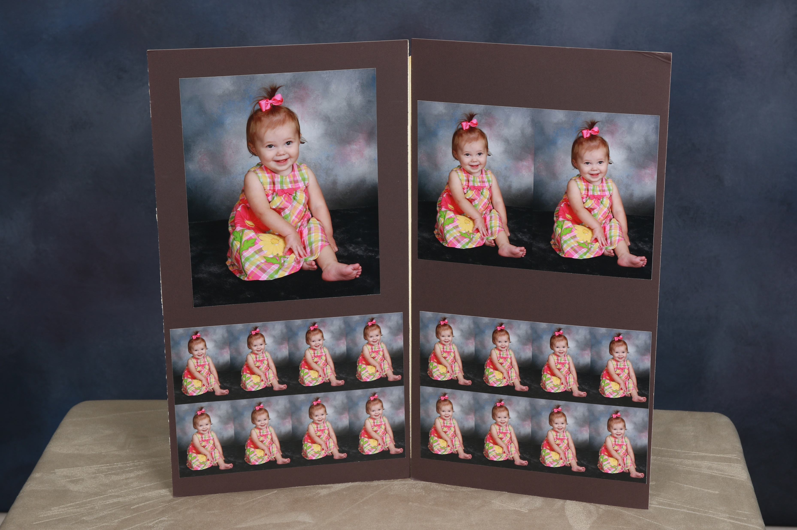
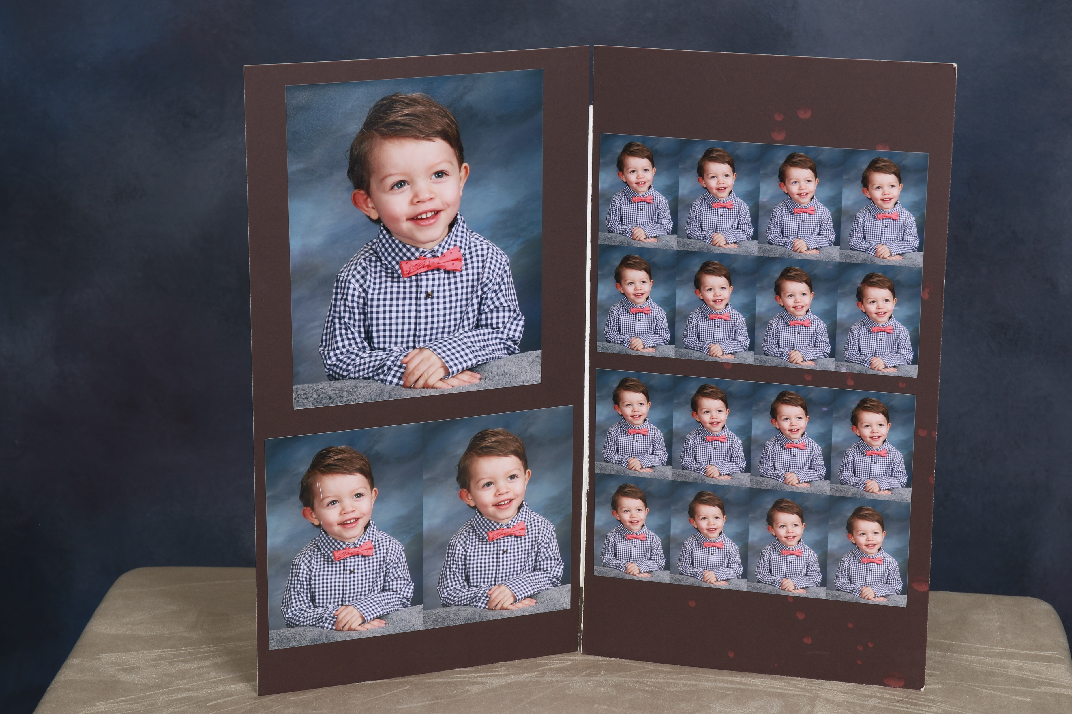

Slide 54
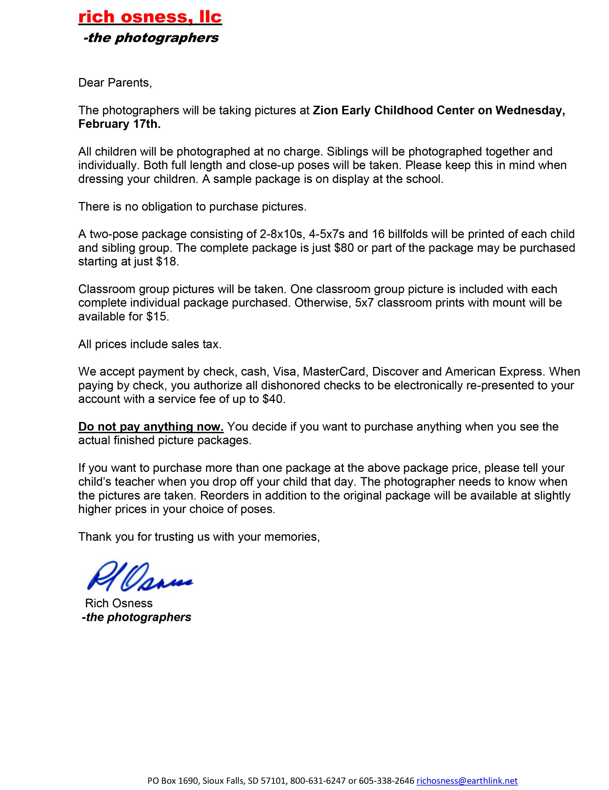
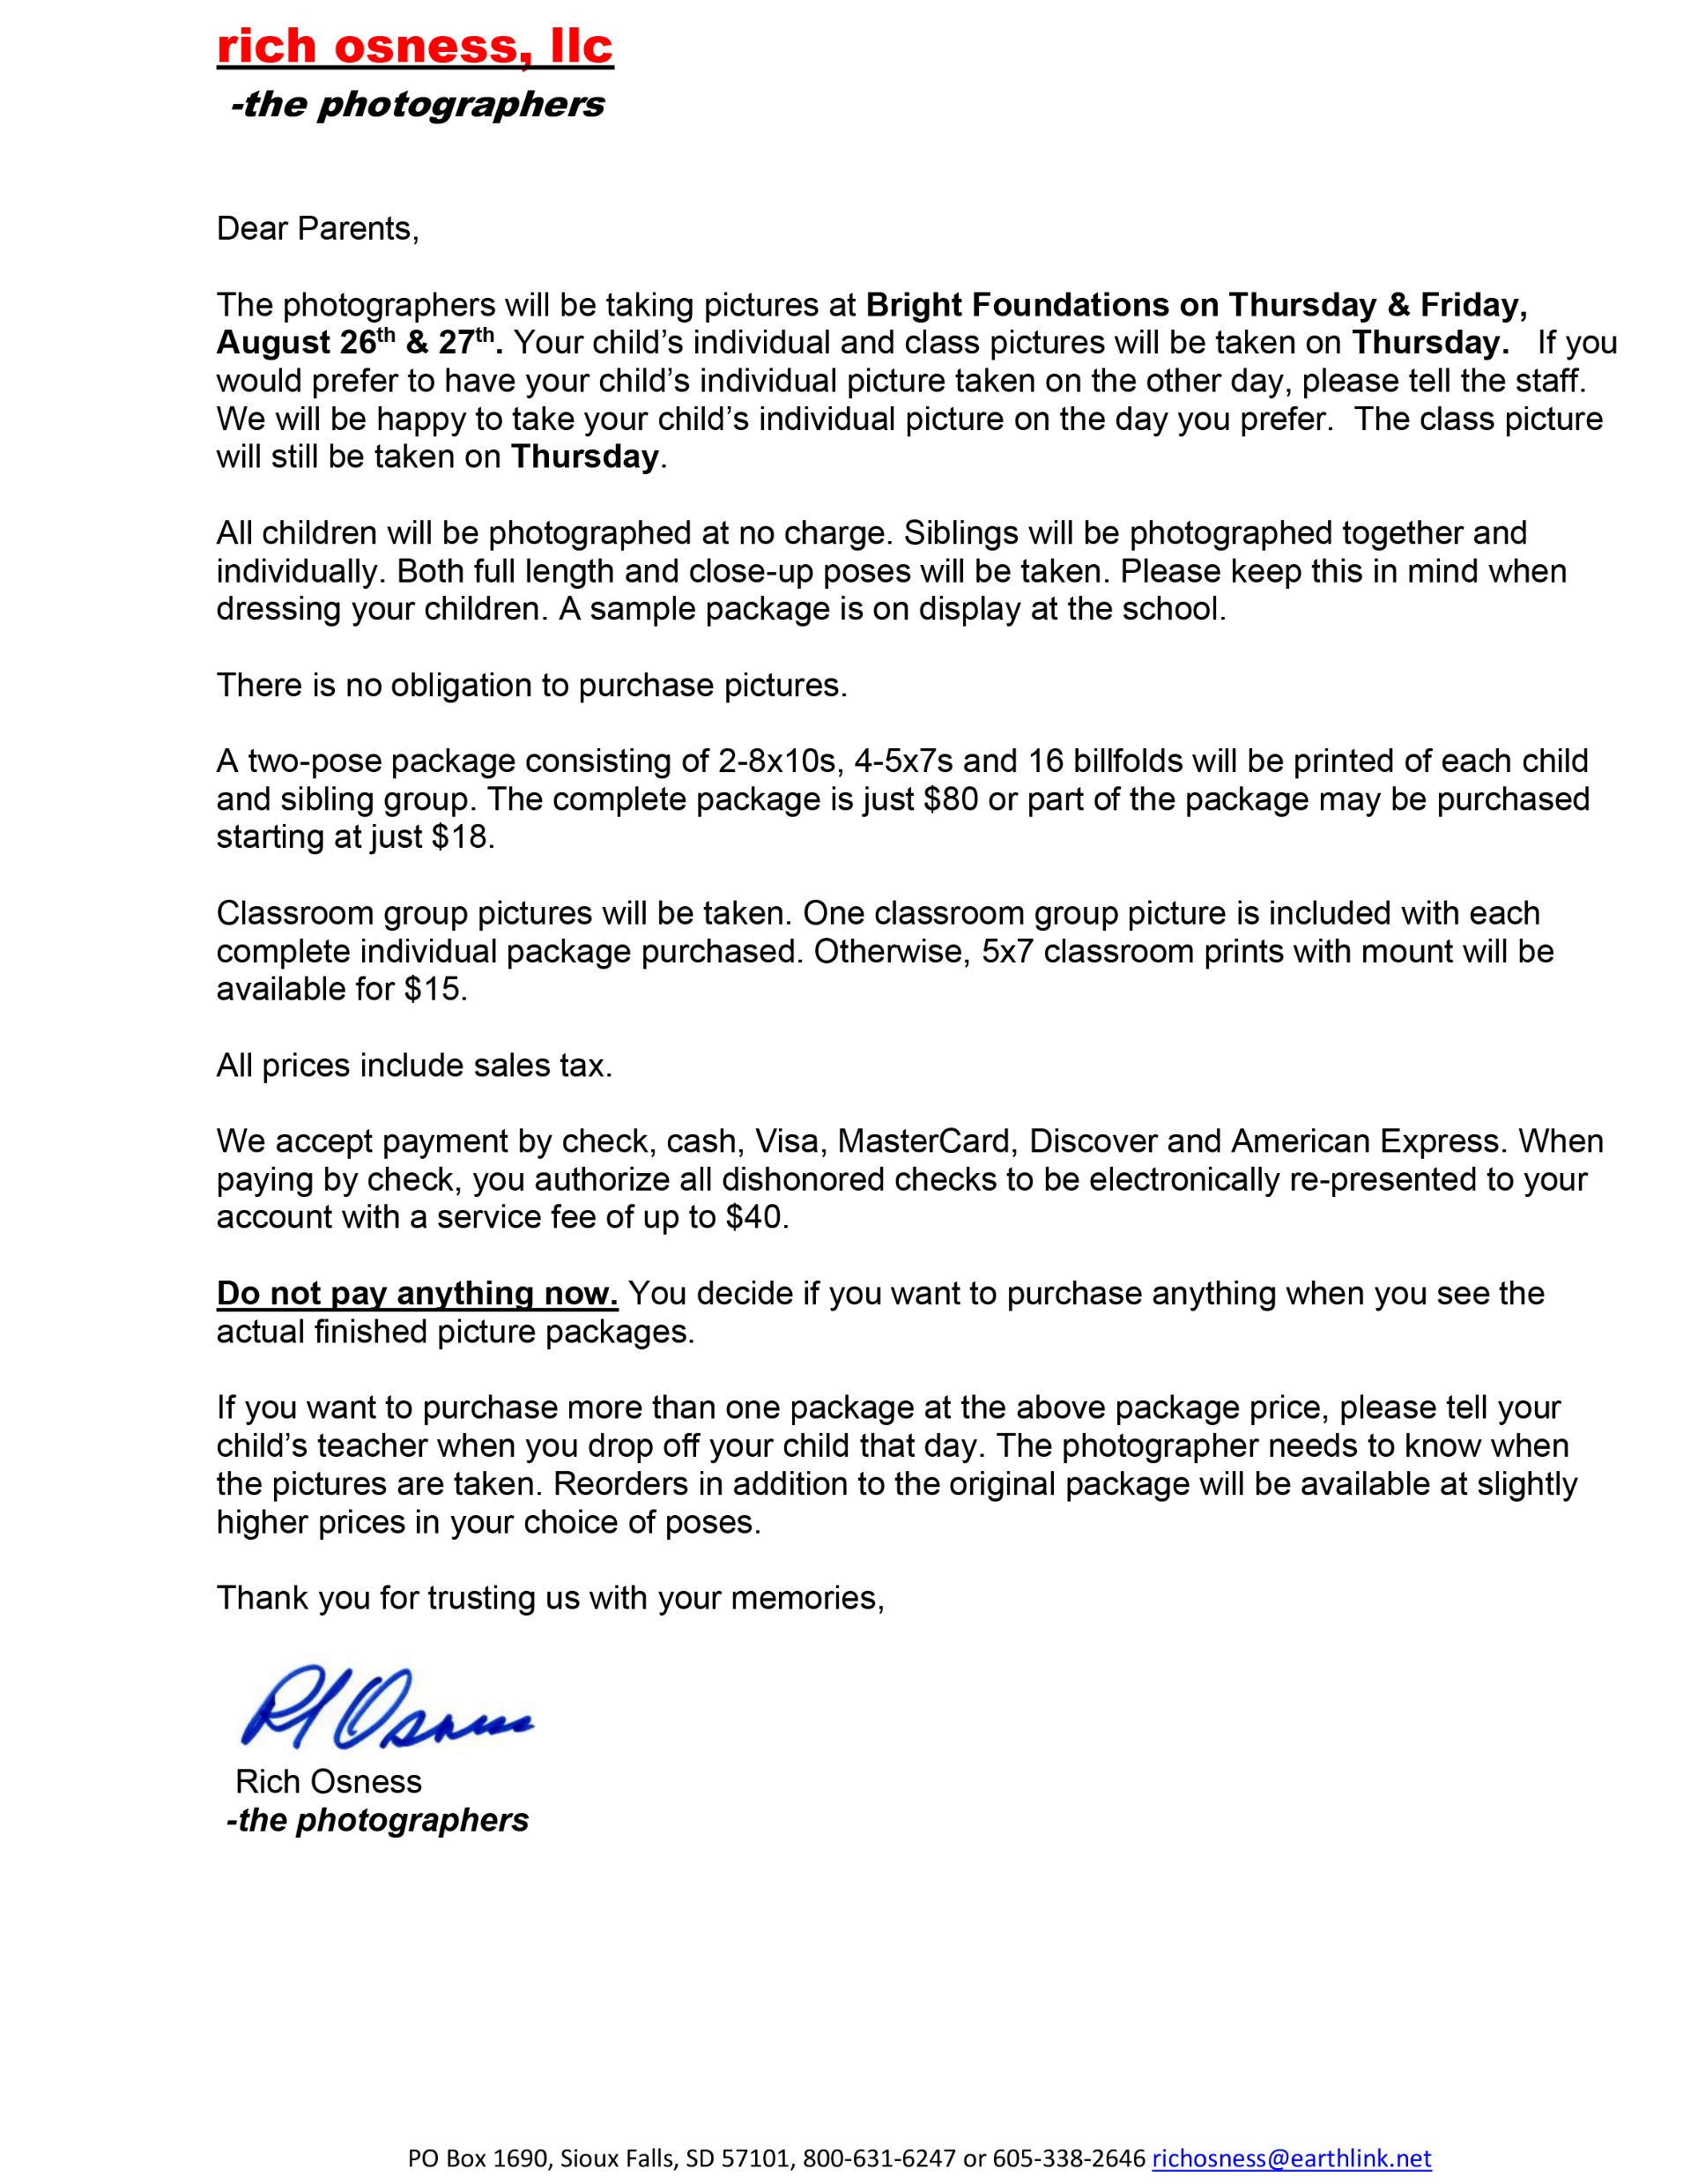

Slide 57
Picture Day
Taking the Pictures

Slide 58
This will take longer
You should be able to do 10-30 children/hour
Not 50-100
If you try to rush younger children
it will take longer
And,
It may get a little noisy

Slide 59
Avoid bringing
an assistant
Make a one person show

Slide 60
Parents and Staff
The parents bring the money
The staff sell your pictures
They’re both important, but you need to stay in control
You will get better pictures more quickly if you stay in control

Slide 61
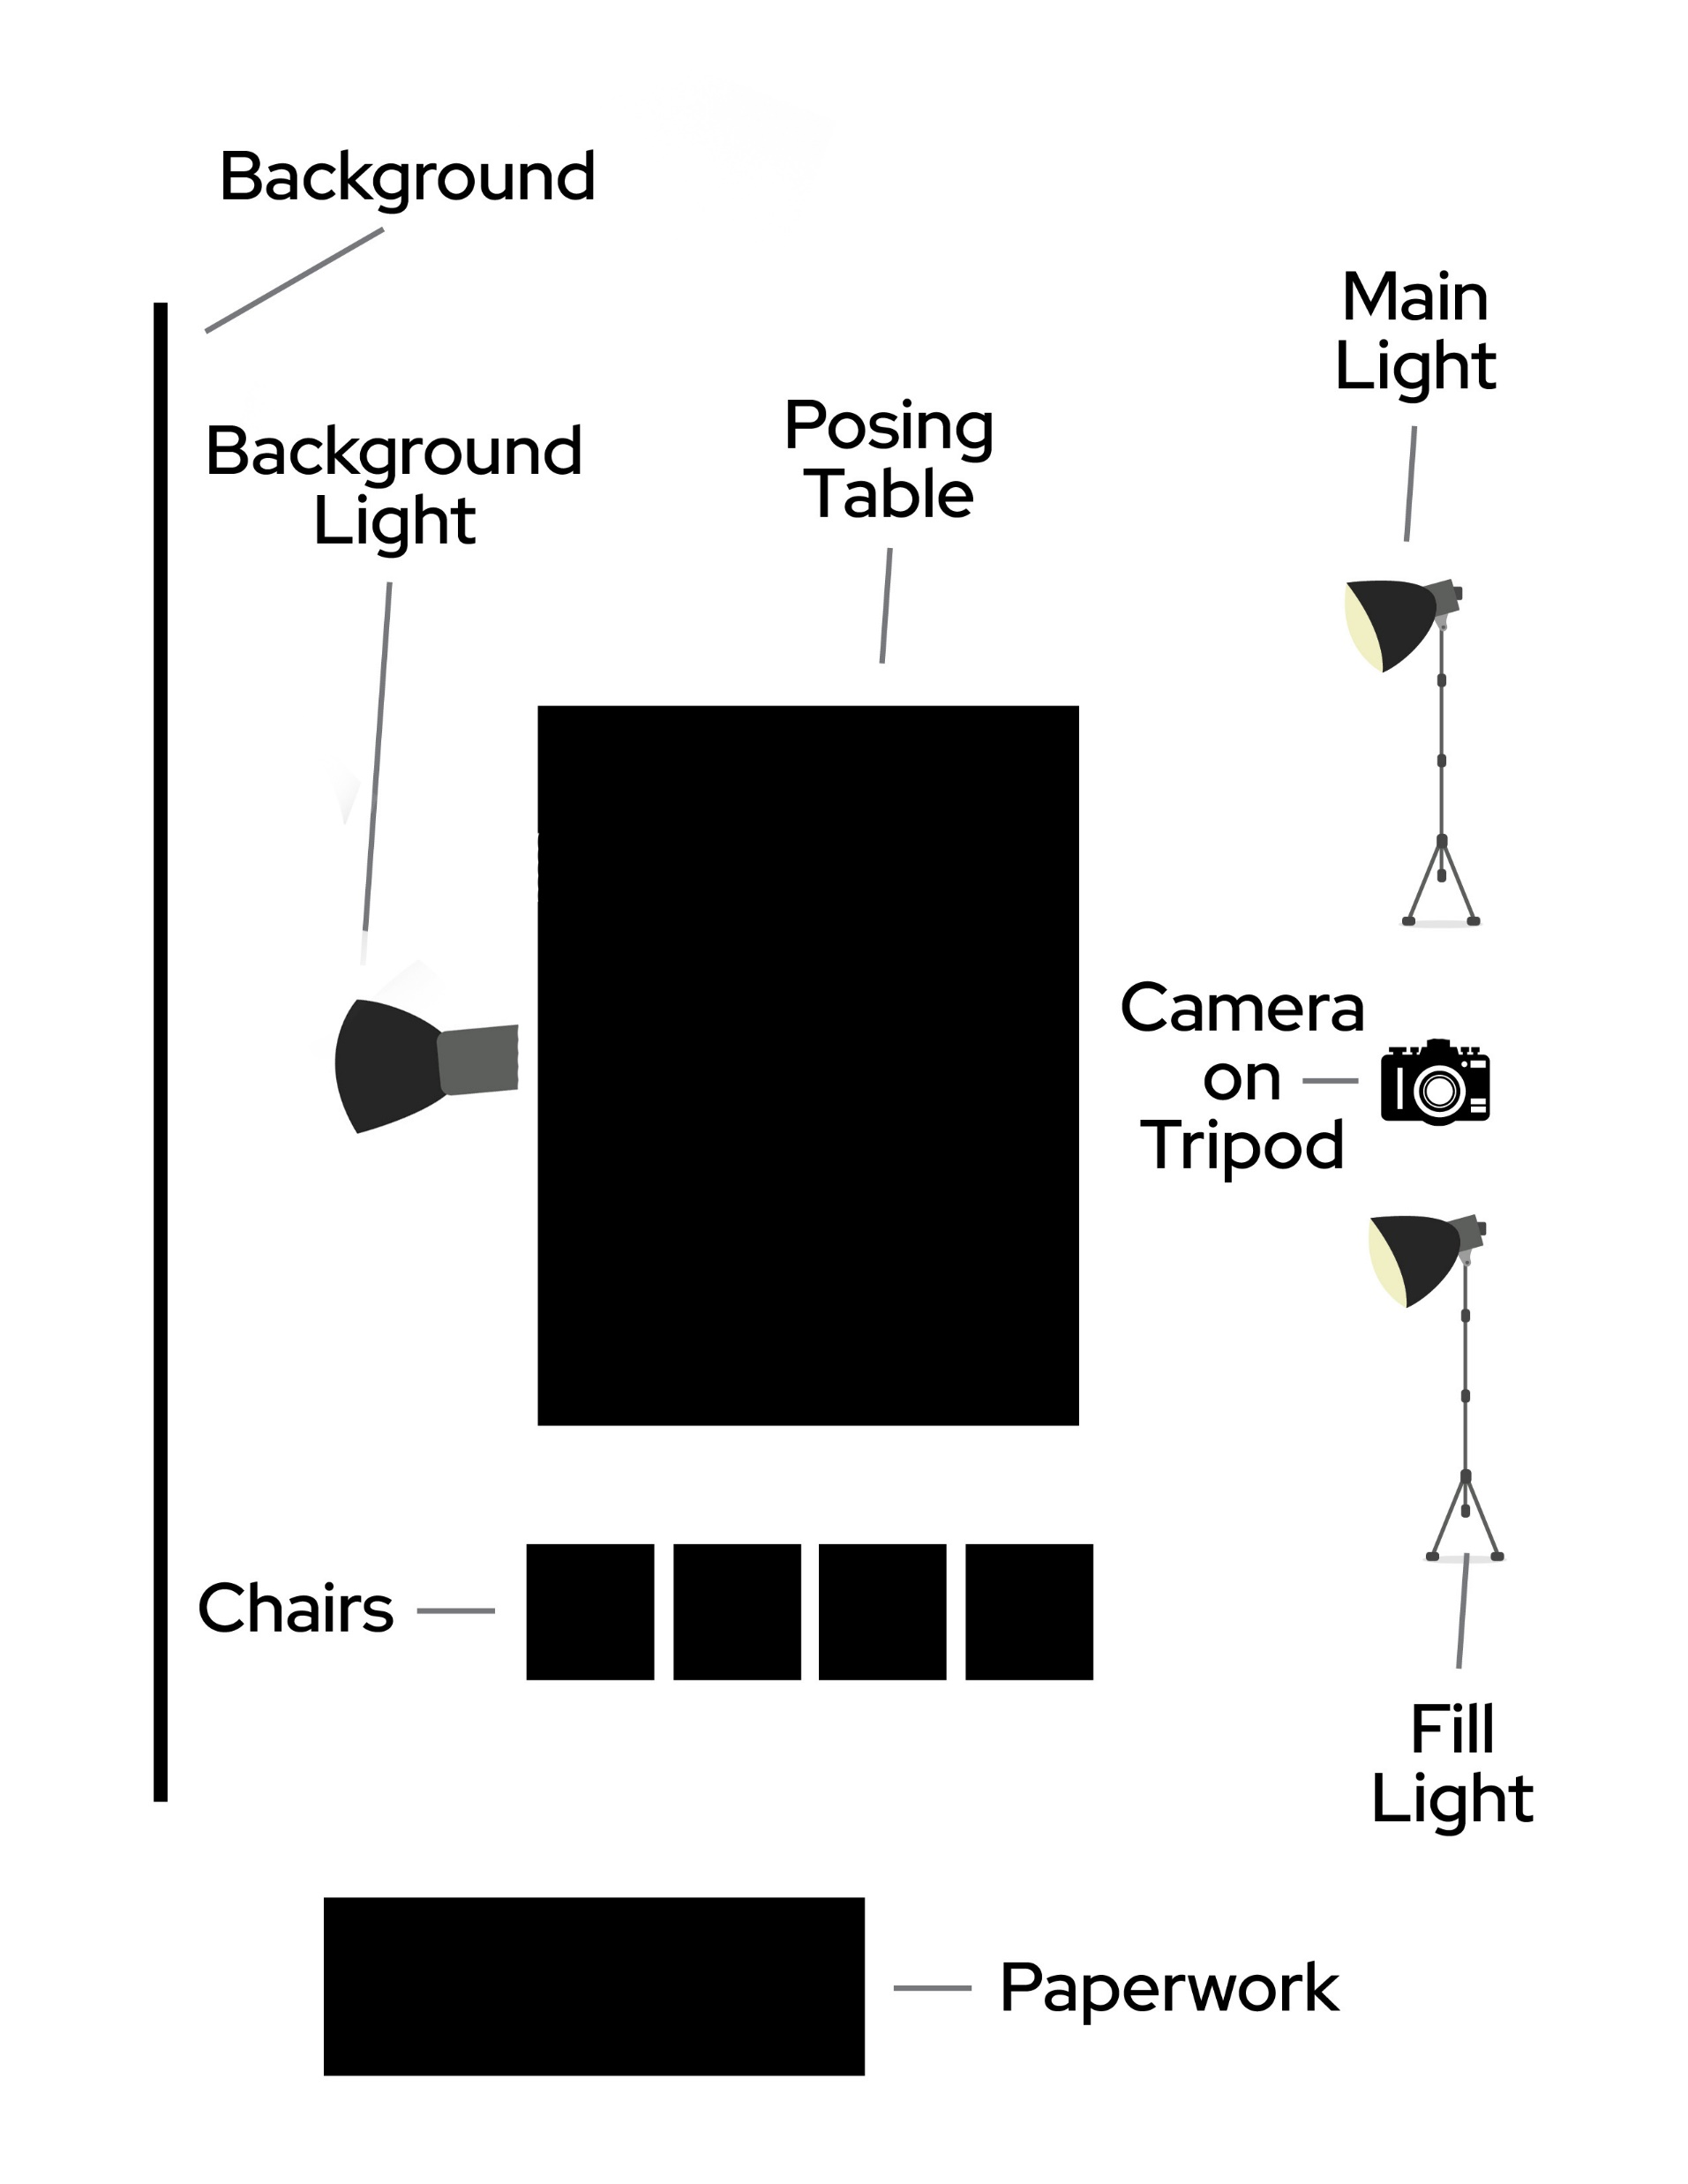

Slide 62
Have a staff person filling out tickets, a class or school roster is useful
Bring the children into the area in small groups
Bring infants that cannot walk into the room one at a time and work them in between older children
Avoid having people behind you
Wipe noses, staff usually don’t know how to do it well
If the photographer is the only one working with the children it will go better and faster

Slide 63
Photograph siblings as groups, sometimes cousin groups sell well, the staff will know
School age kids don’t sell as well because----but photographed with younger siblings?
Print double packages of children from split families

Slide 64
Things to Remember
Get Done by lunch/nap time
Save none-nappers till after lunch, if you don’t get done by lunch
Do toddlers and older infants well before lunch
Do younger infants when they are awake

Slide 65
Class Groups
Stop doing individuals and do class groups about mid-morning
Do infant groups whenever the infant teacher wants
Take the class groups in their rooms or some place they want to represent their school
Use a single light, keep it simple and quick

Slide 66
Props & Backgrounds
Simple, Classic Portraits Sell Better
Except
I usually avoid props
Rocking Chair for older infants
Special items belonging to the child
Cap & Gown Pictures

Slide 67
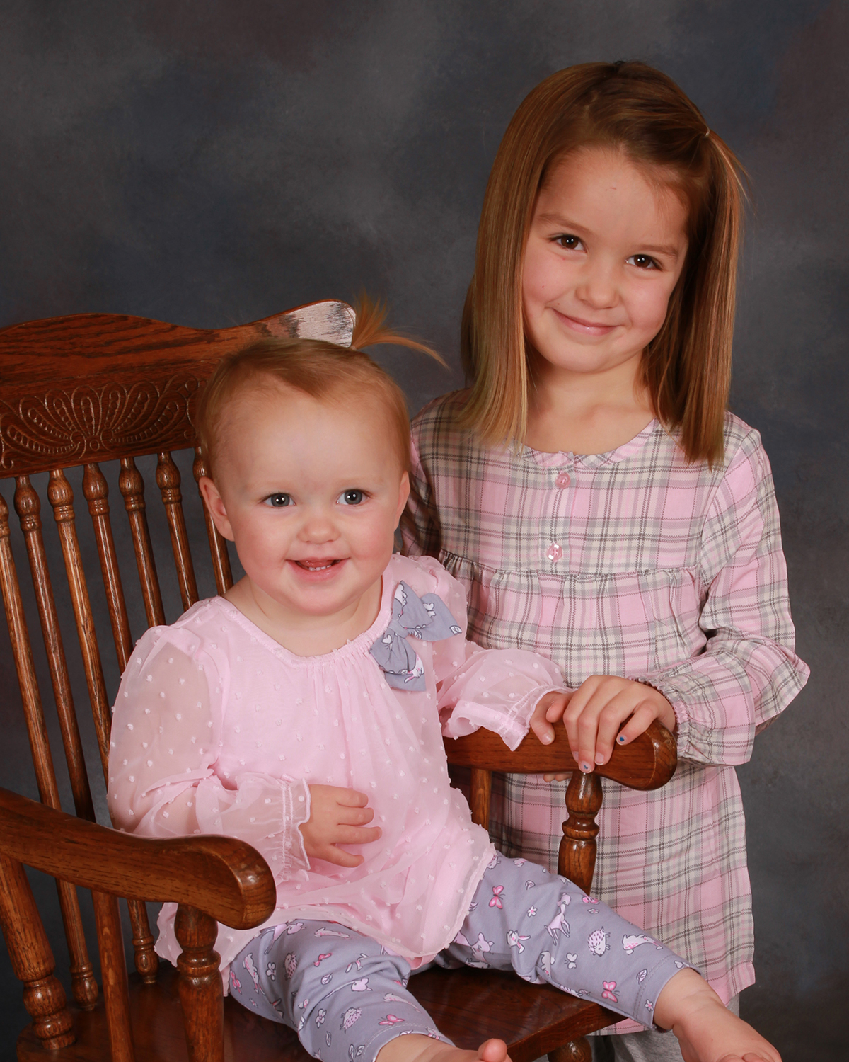

Slide 68
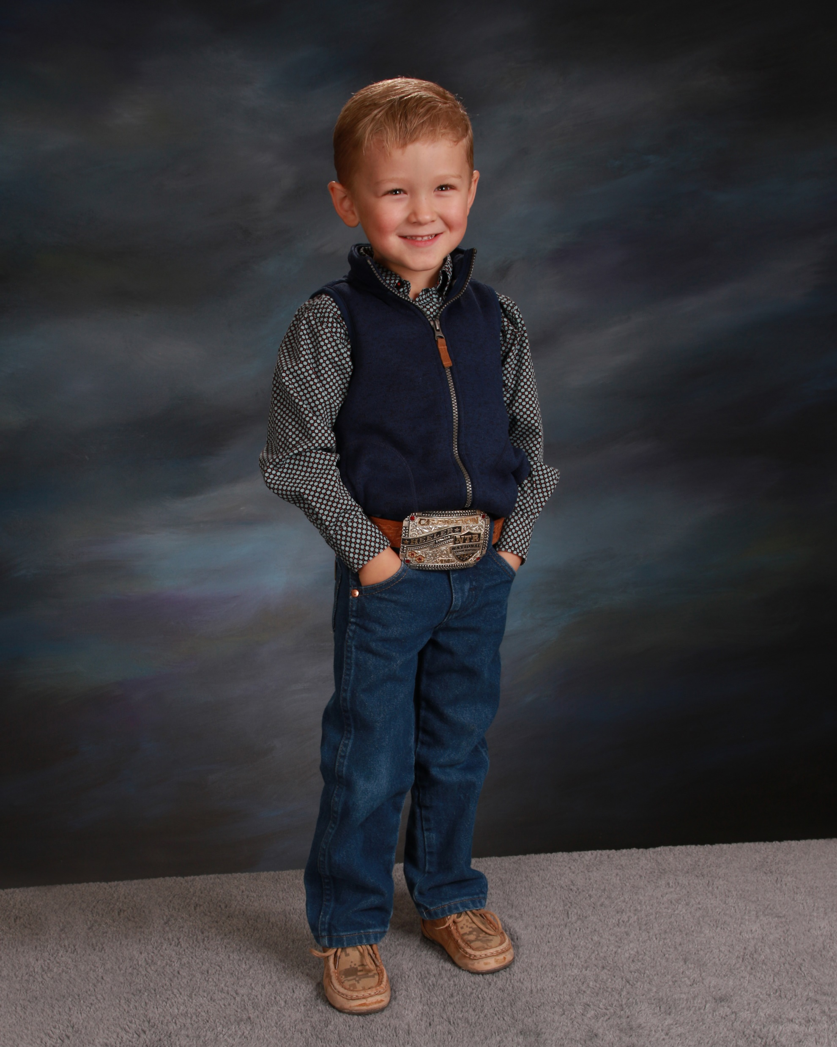
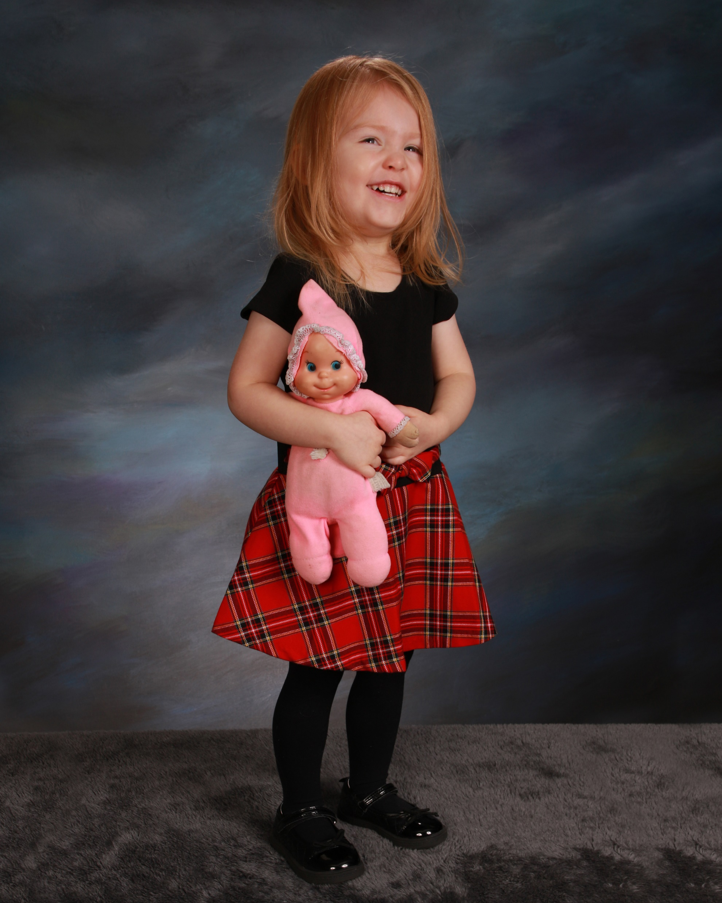

Slide 69
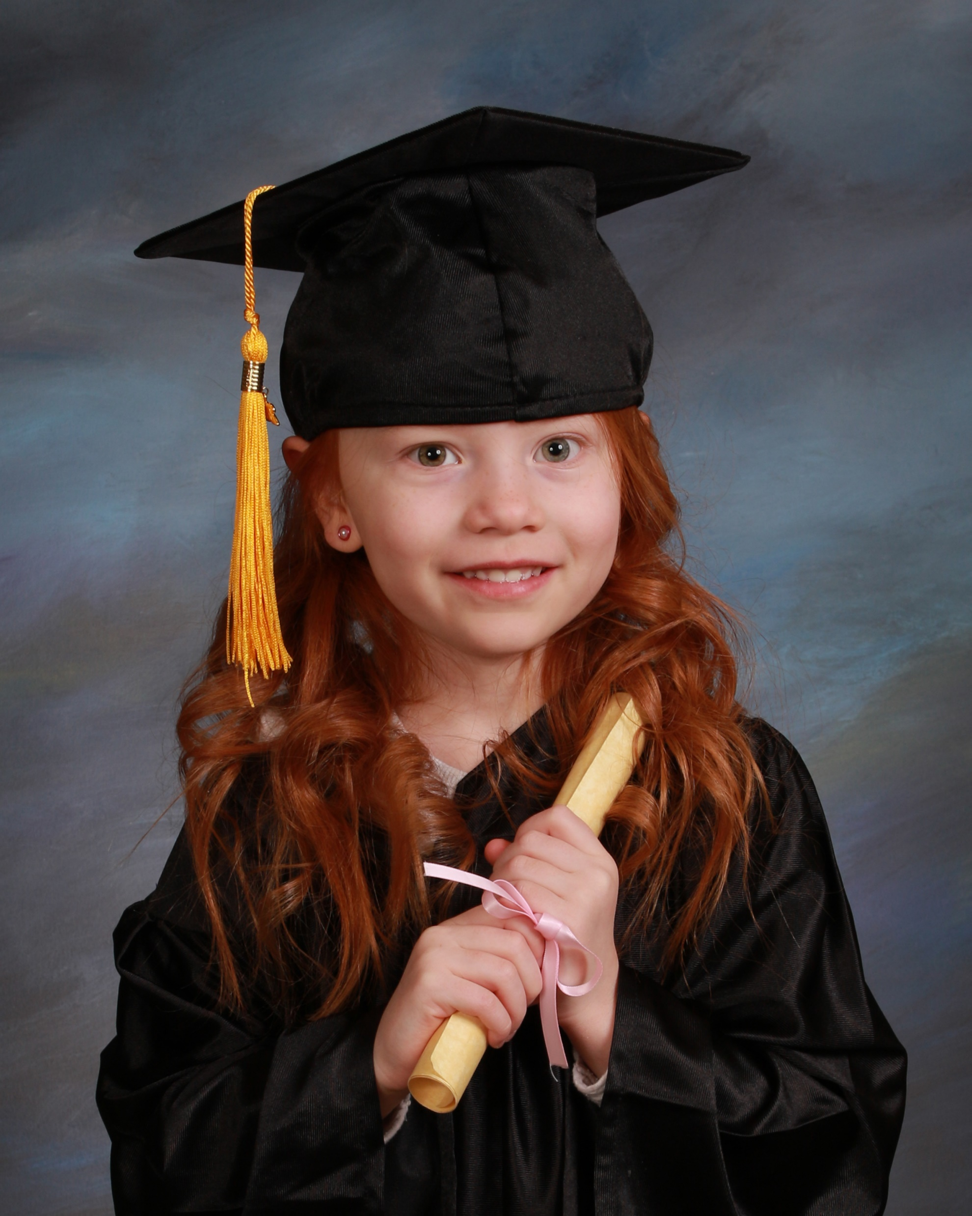
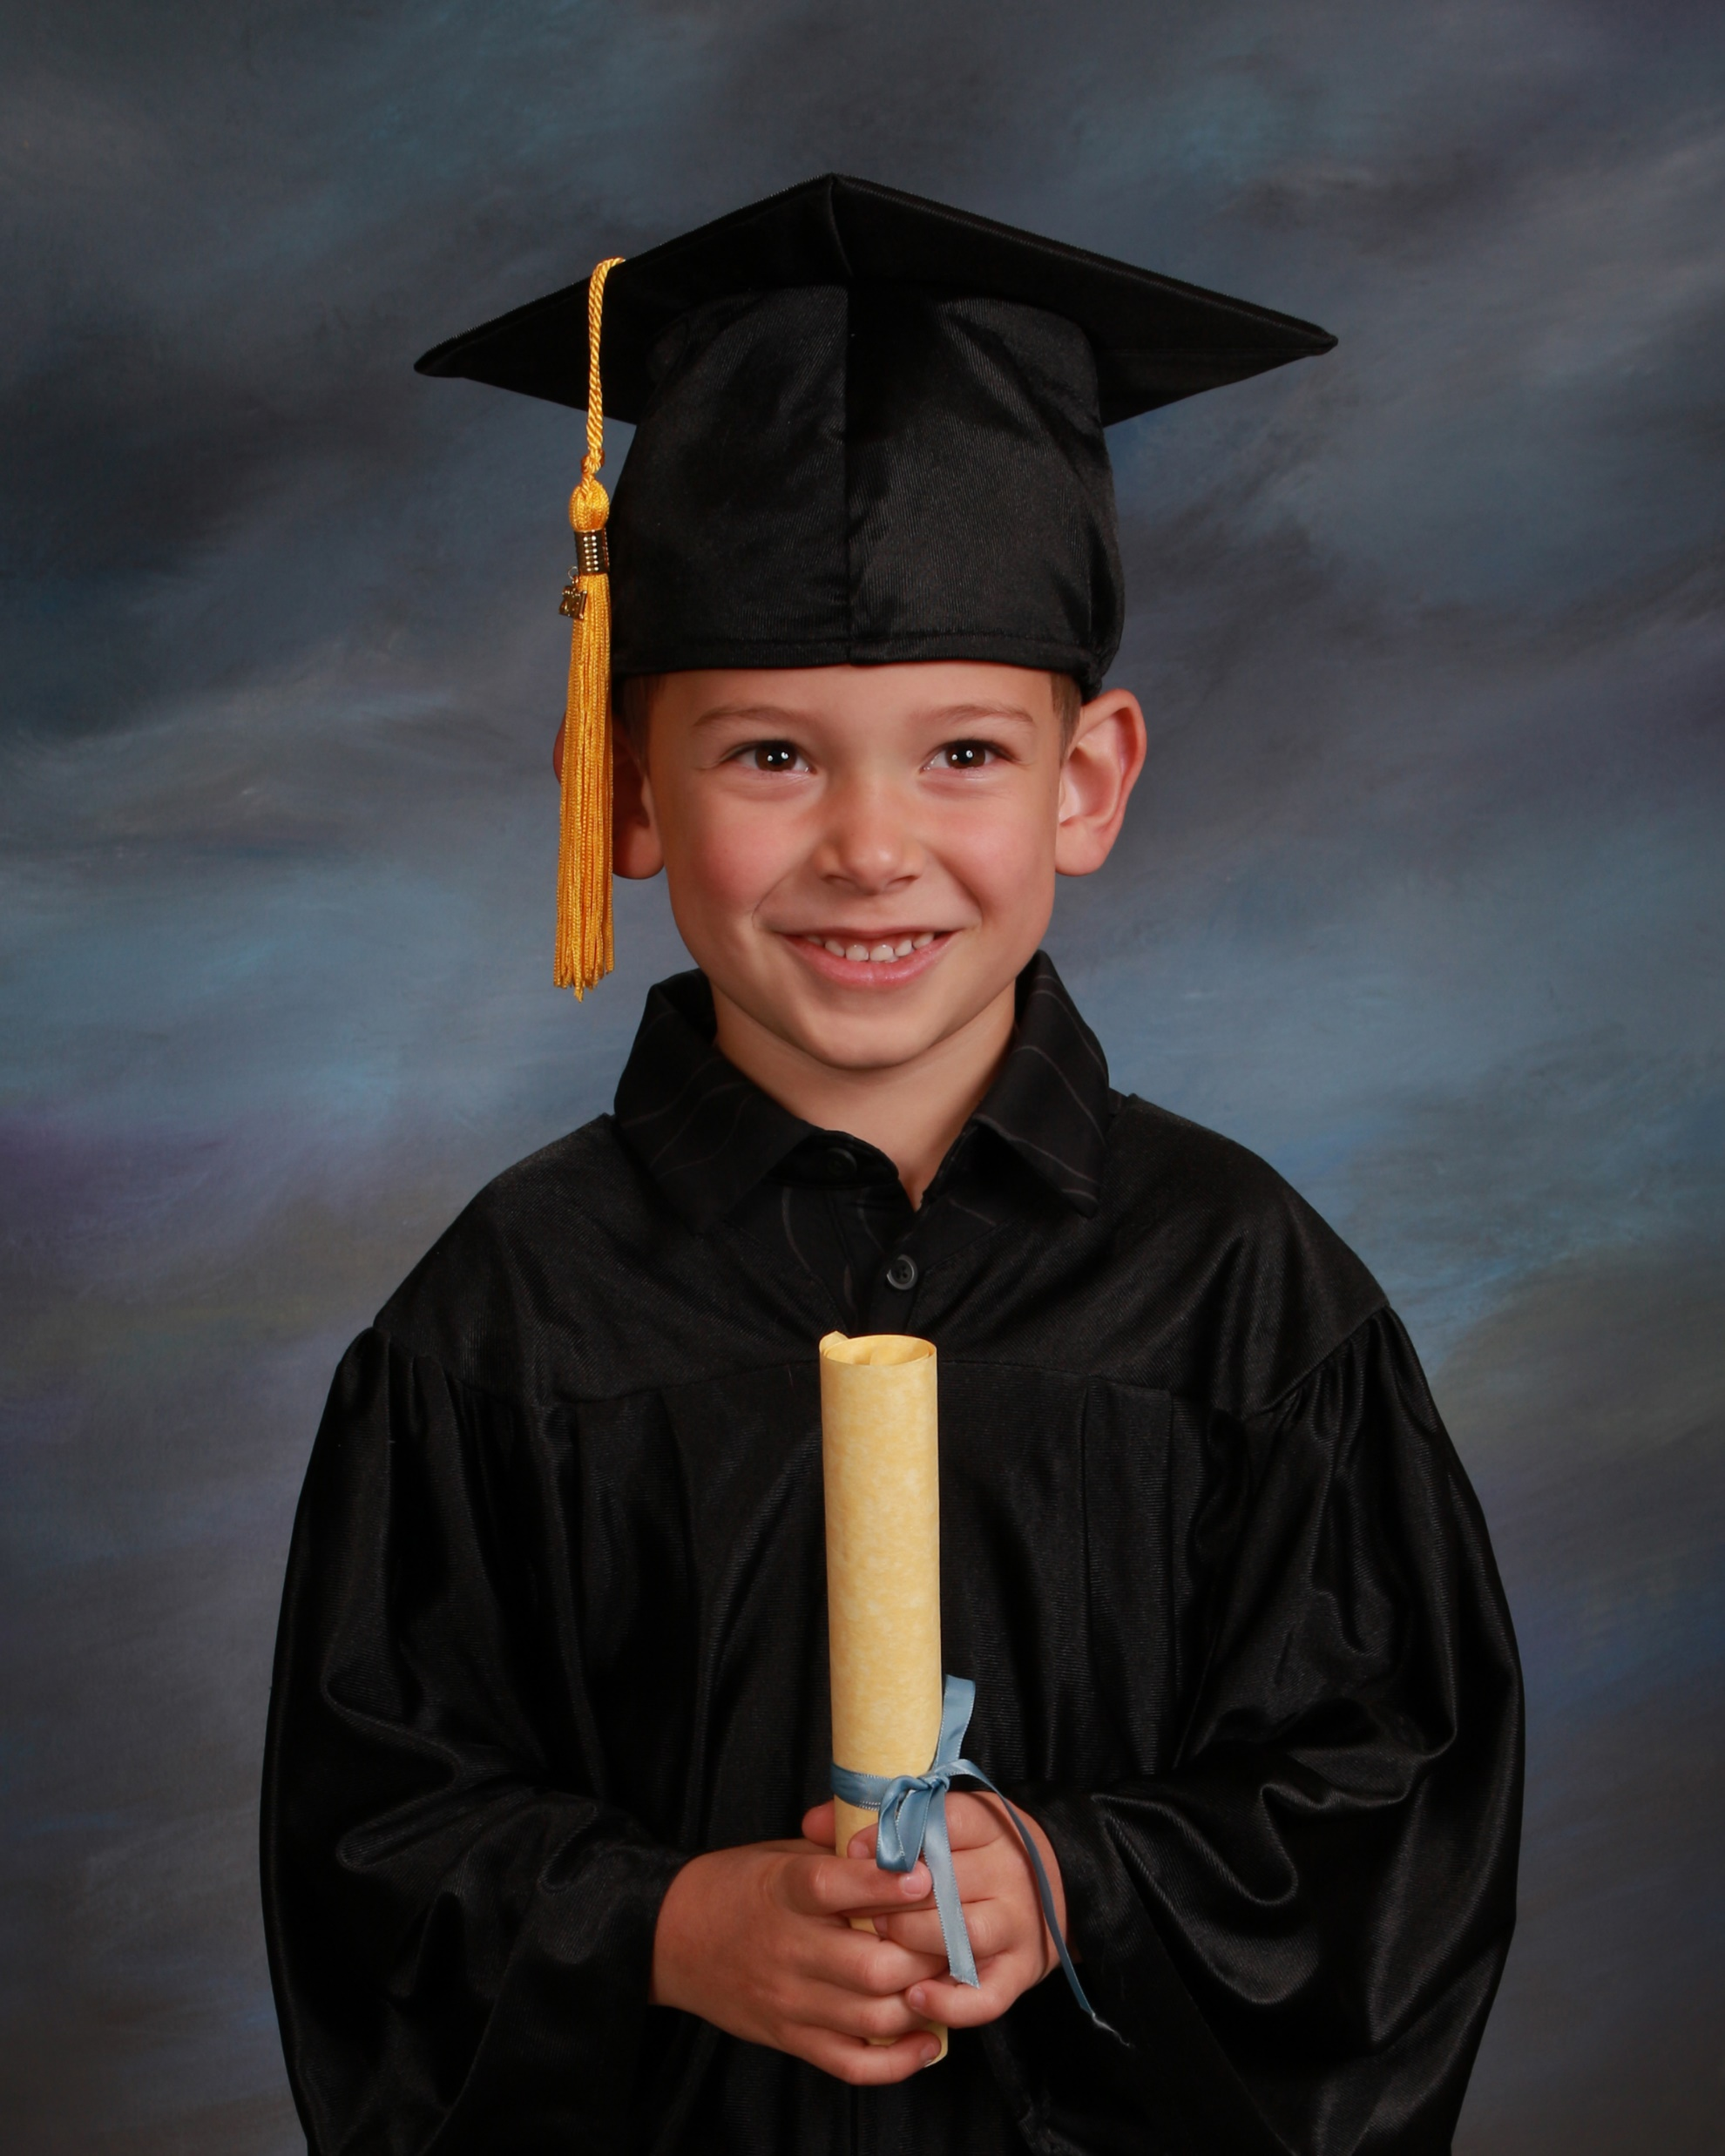

Slide 70
Retouching
Dirty Noses
Fake Tattoos and Stamps
Scratches, Black Eyes
Eyeglass Reflections
Drool on faces or clothing
Spots on clothing

Slide 71
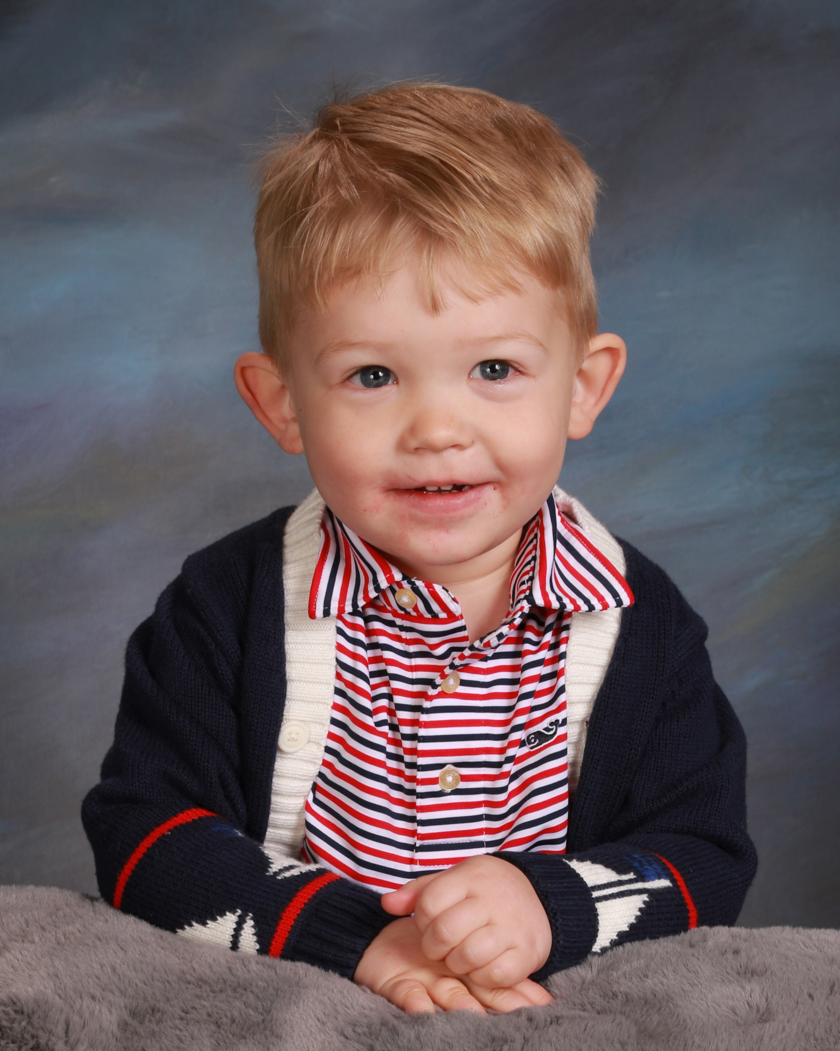
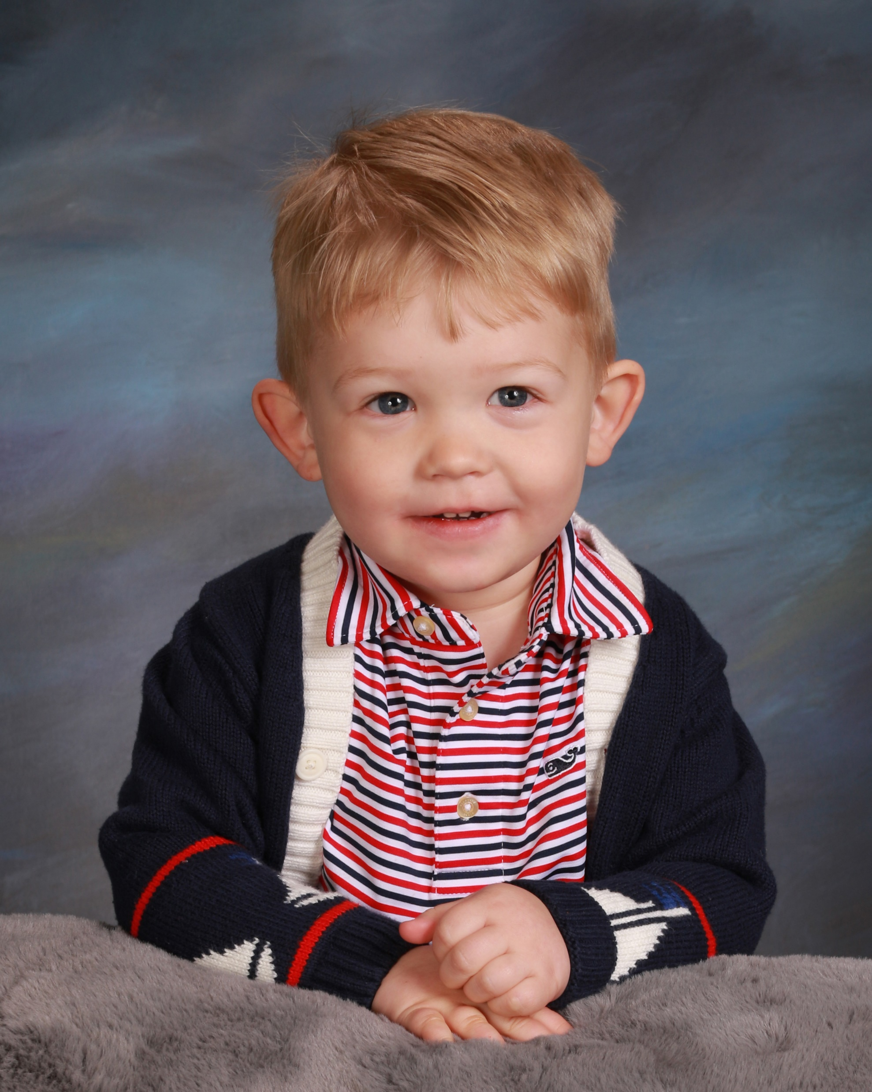

Slide 72
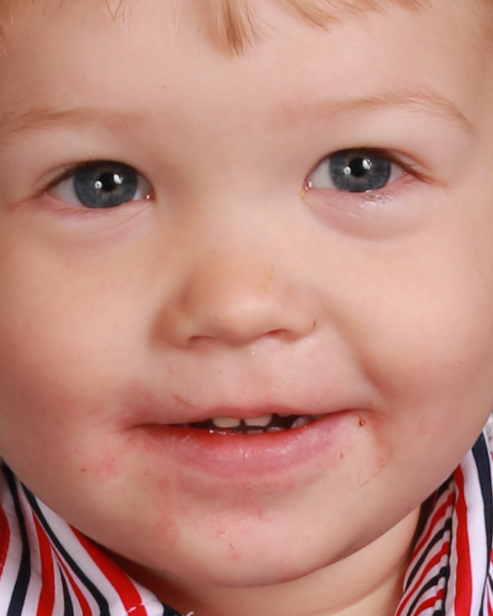

Slide 73
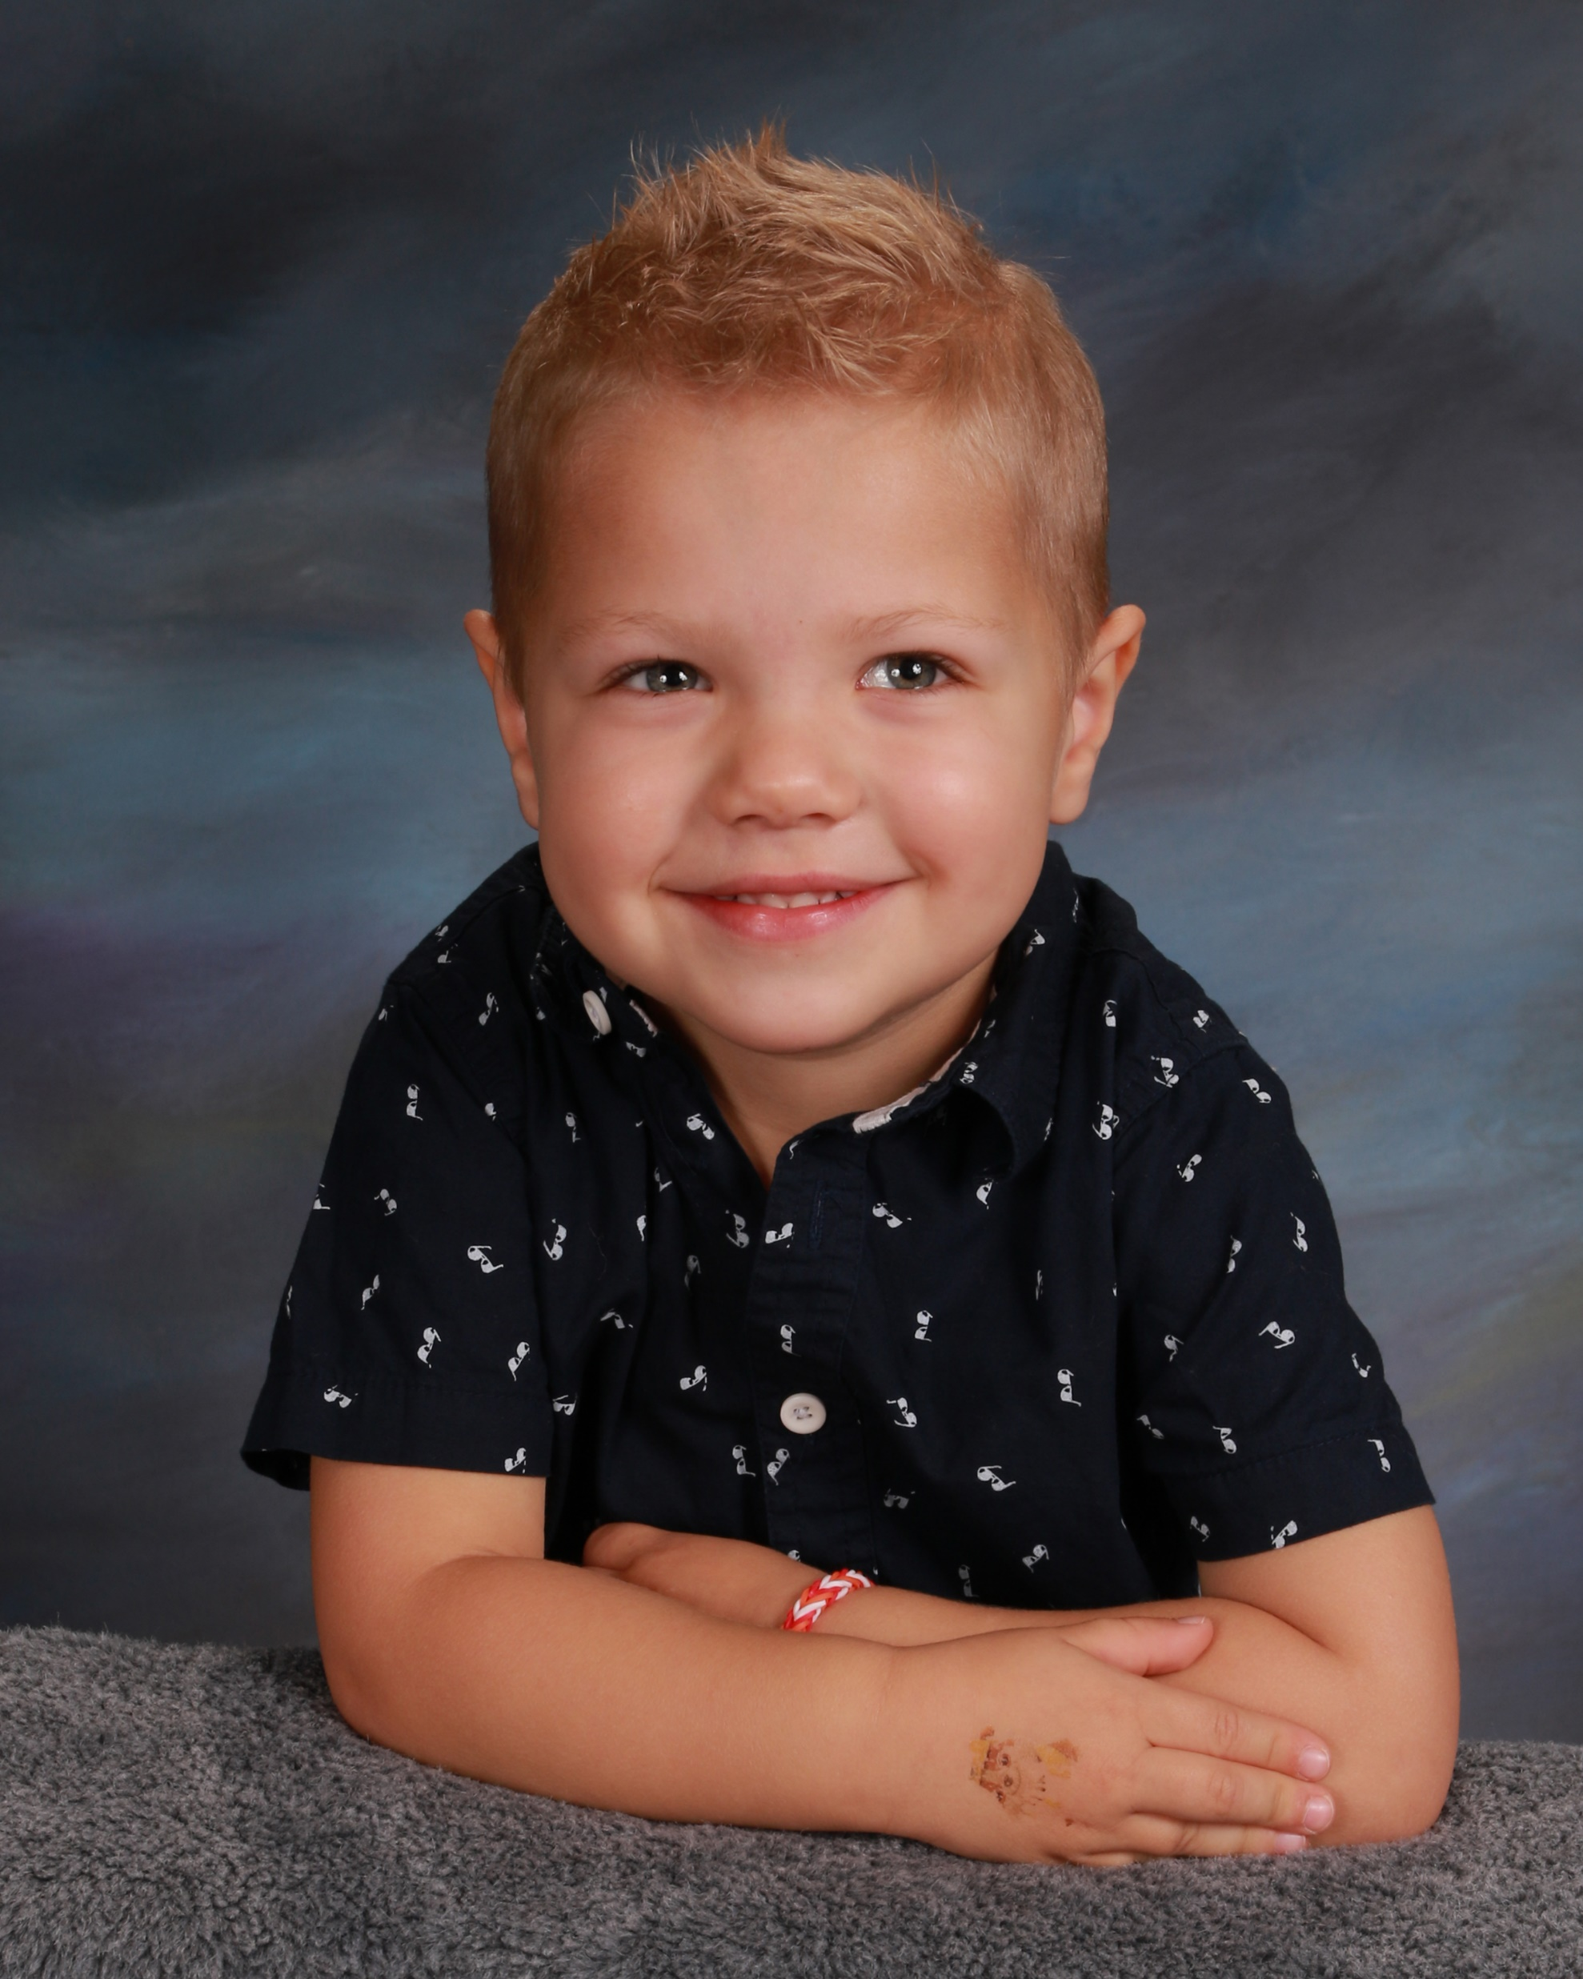
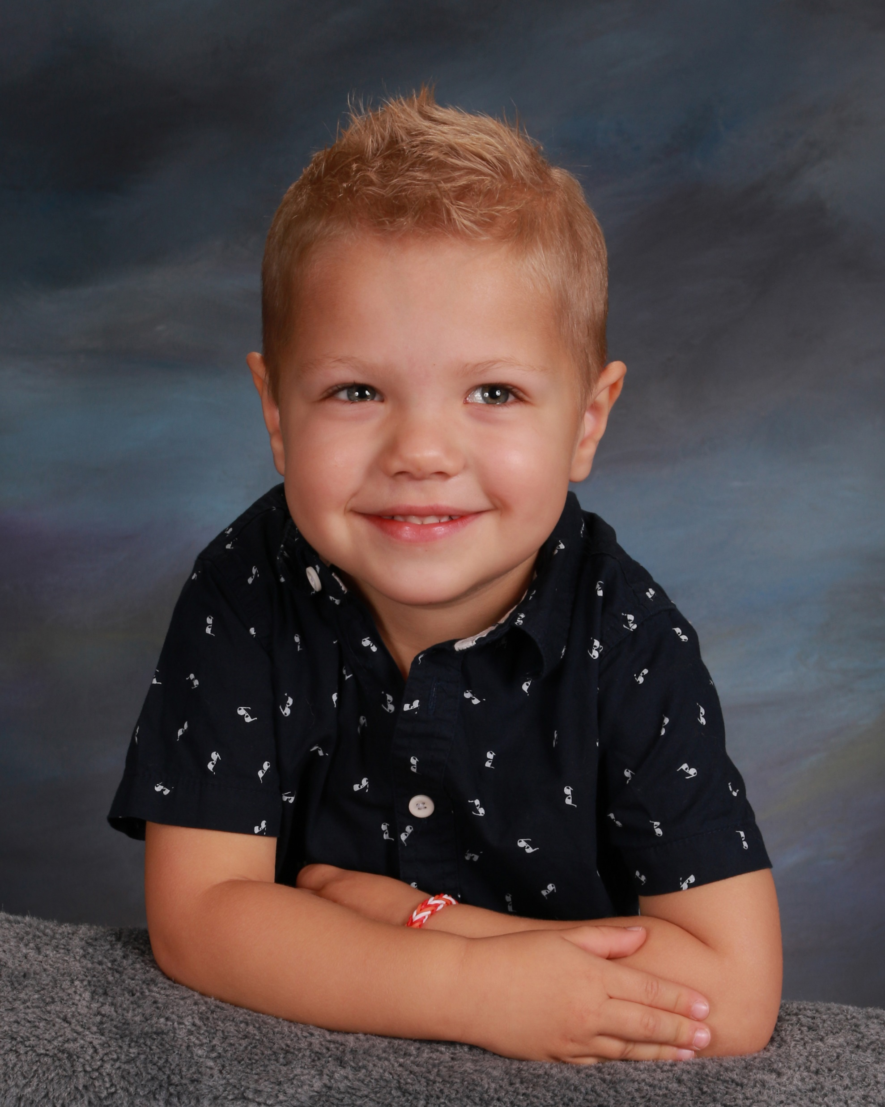

Slide 74
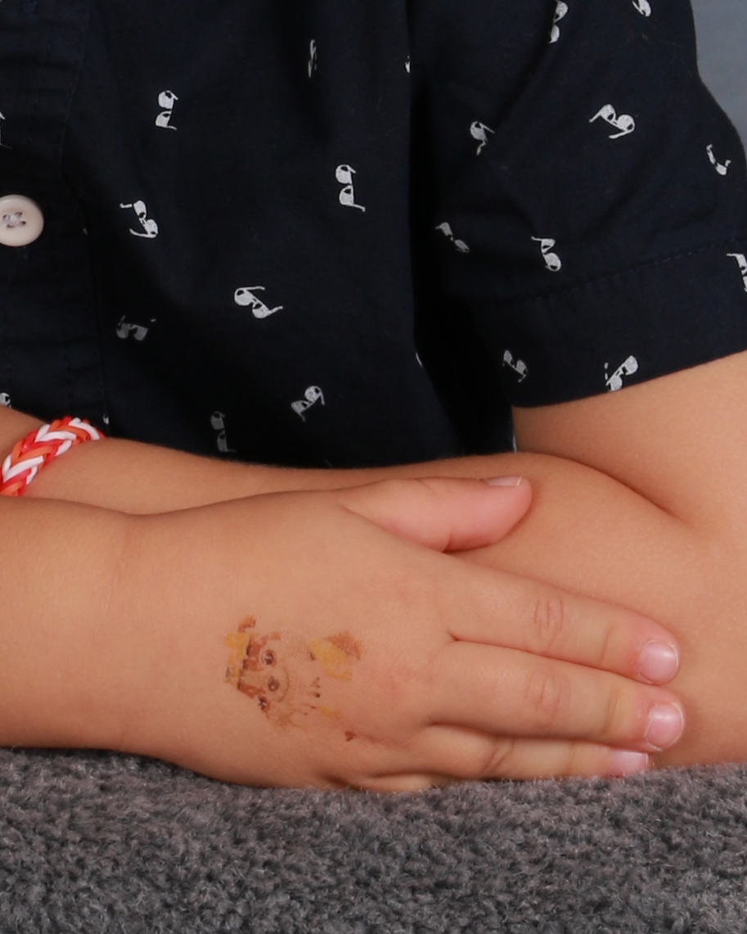

Slide 75
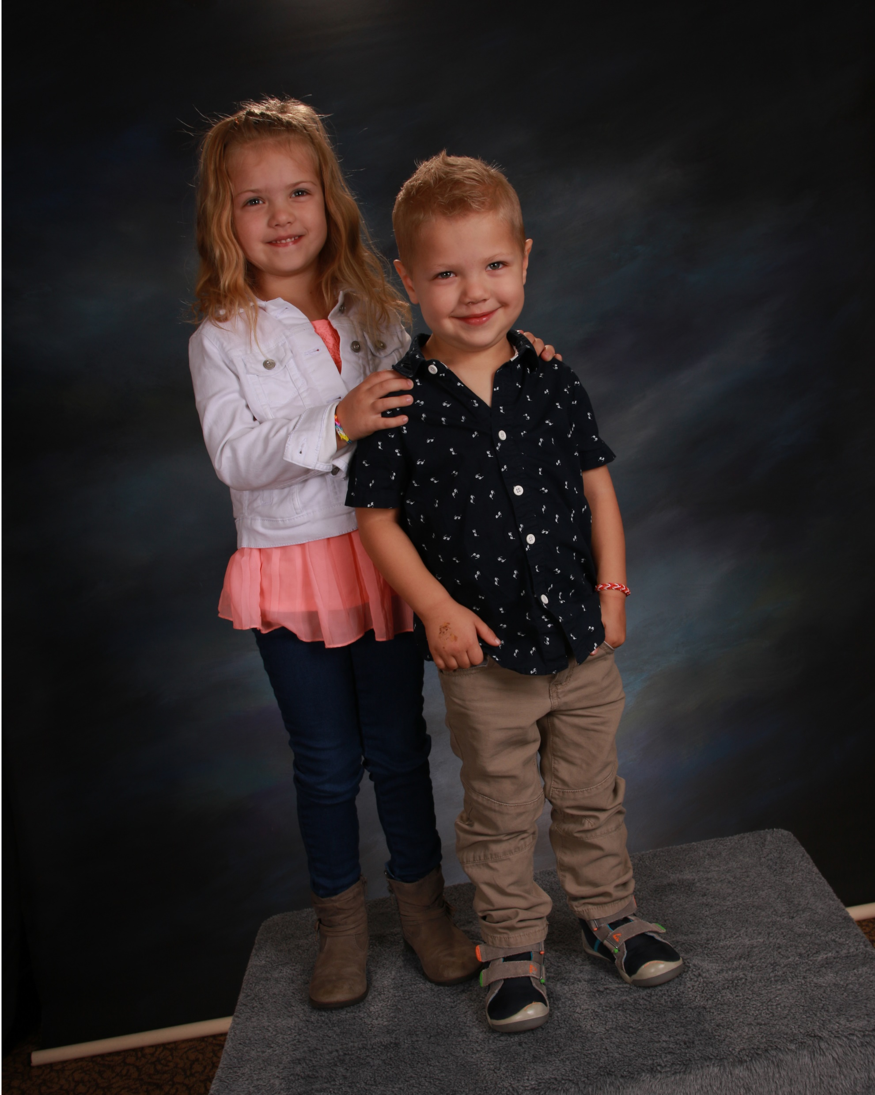
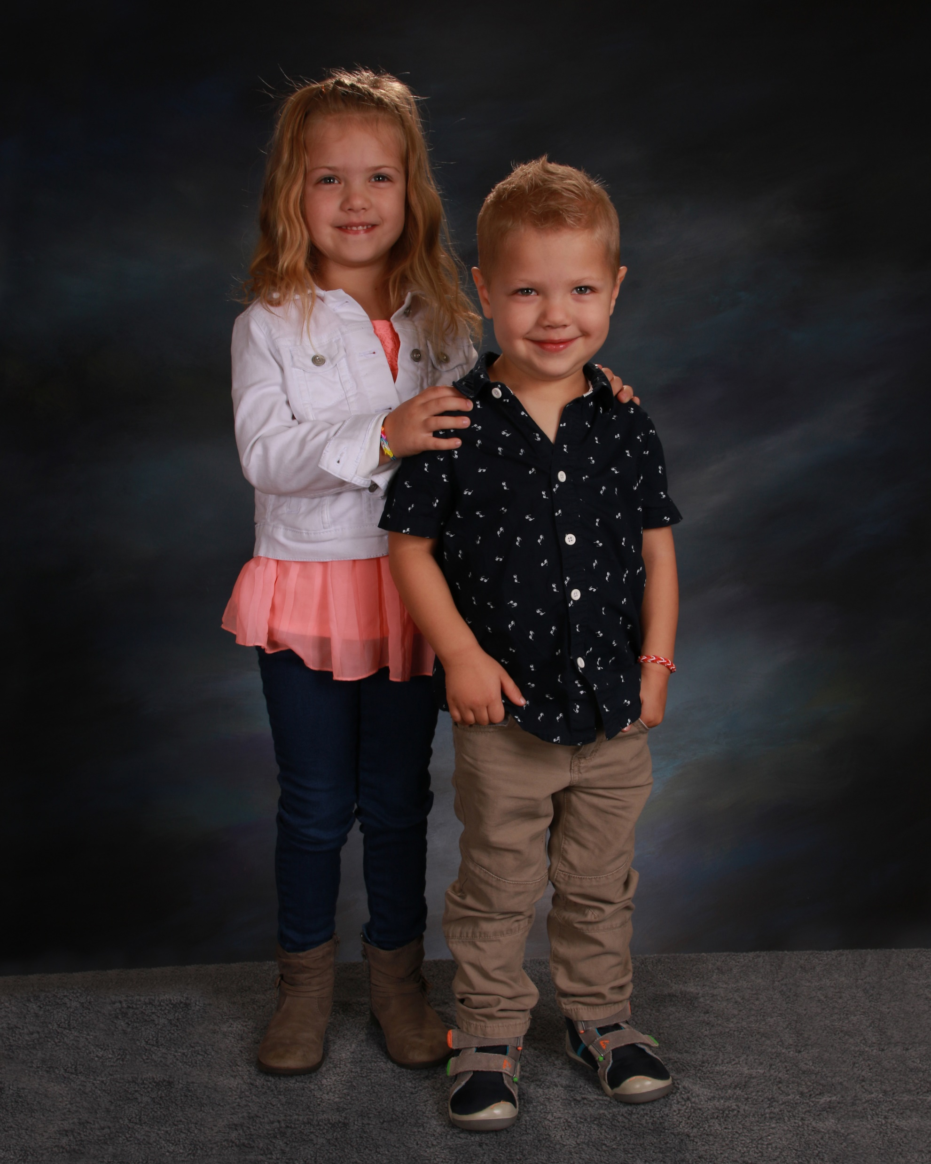

Slide 76
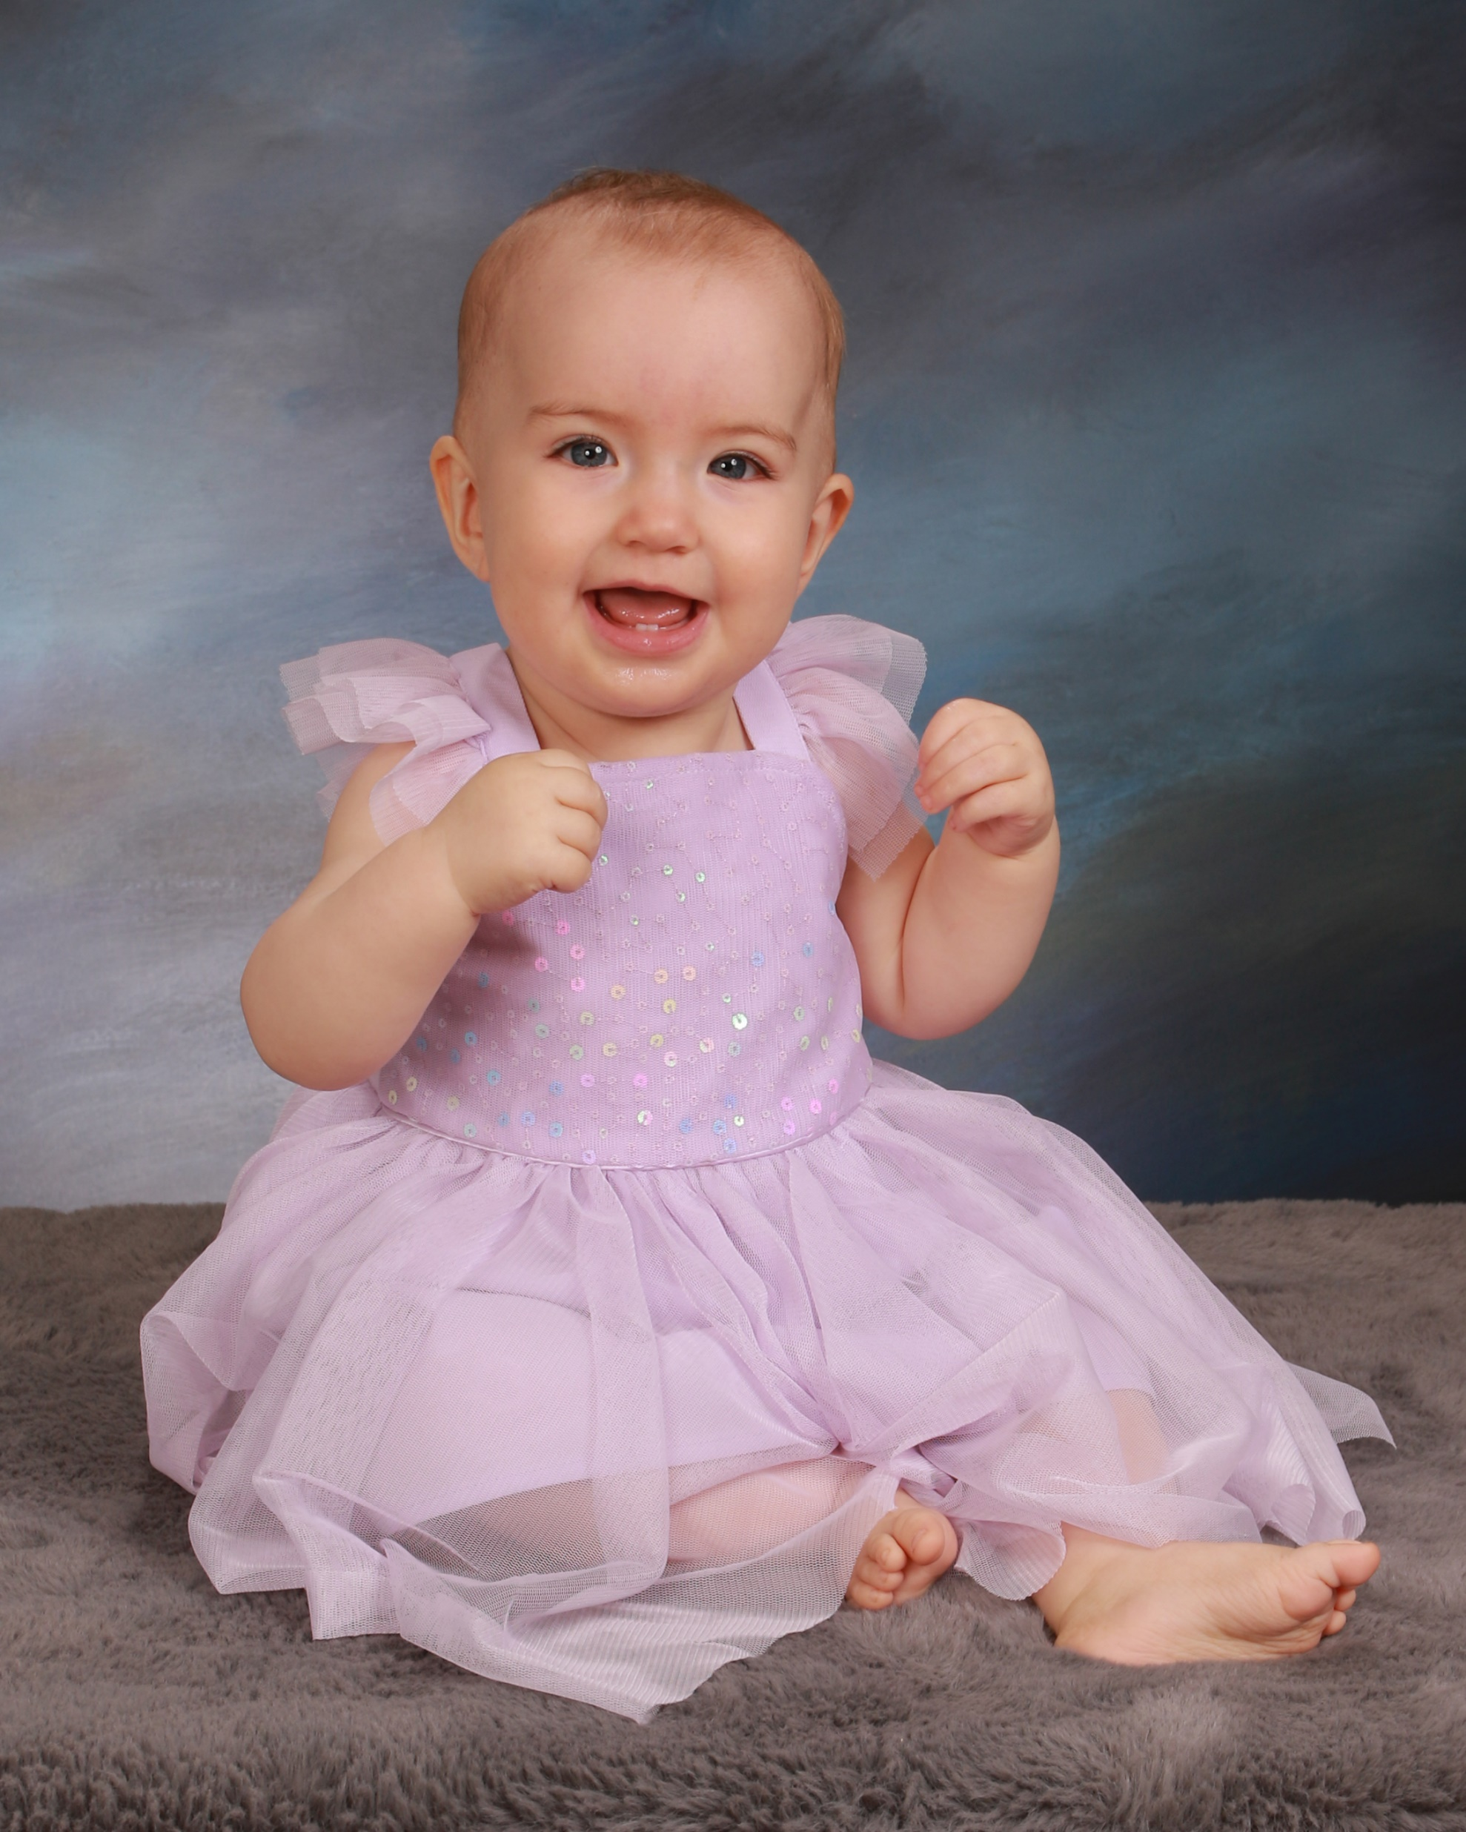
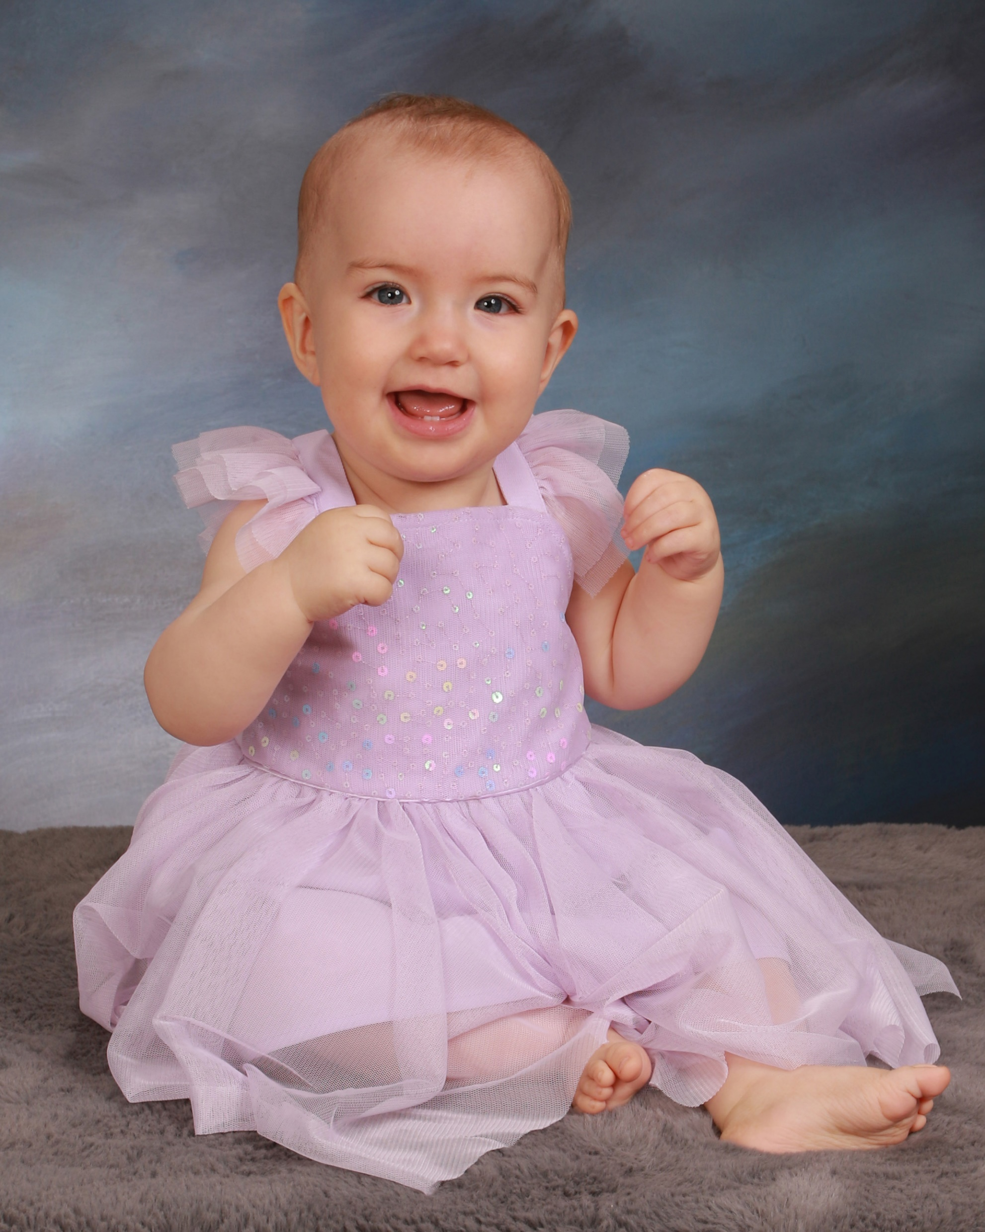

Slide 77
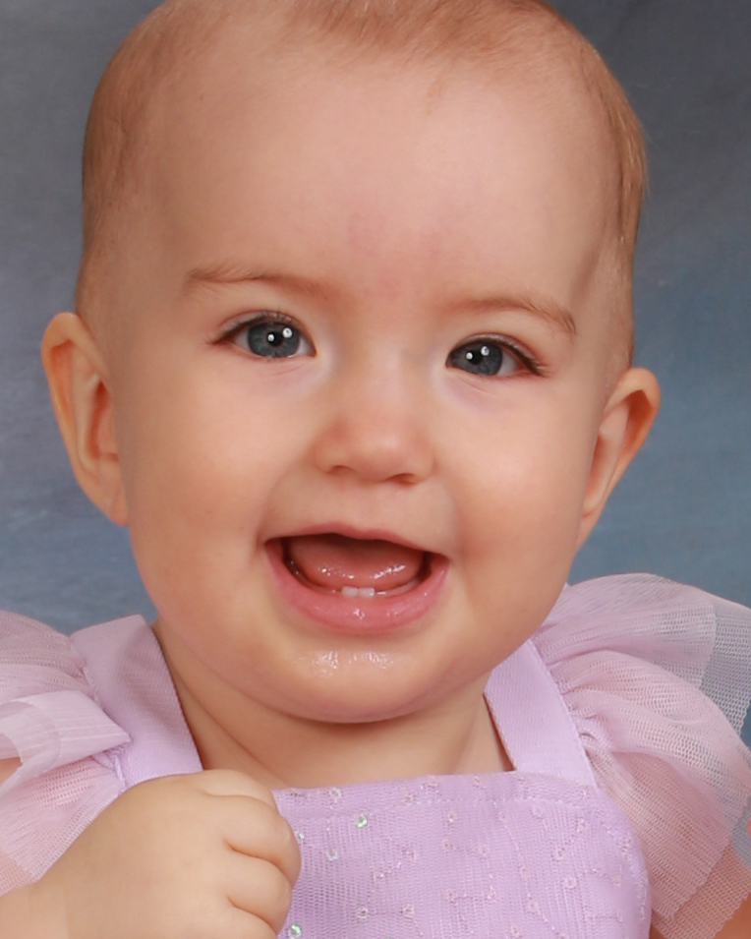
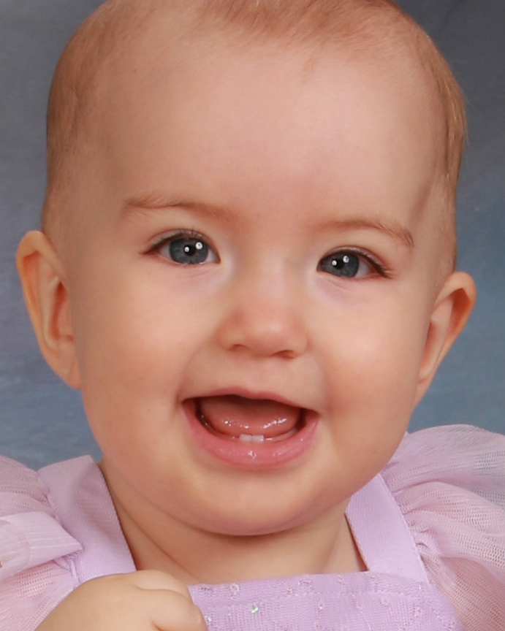

Slide 82
Sitting Tickets
and Packaging
4 Mil Plastic Bags

Slide 89
Reorders

Slide 90
Most common reorders are:
Digital files on disc or flash drive, we include every image we took and the class picture
8x10 portrait units
We offer larger prints including mounted and lacquered prints. We sell very few.

Slide 91
Selling the Packages
Alphabetize Packages
Accounting Sheets-Alphabetized
Instructions-Detailed
Instructions-Most important(for those who don’t like instructions)
Pictures back poster
Envelope for payments
Extra Bags for partial sales

Slide 98
Getting the Money
(Kinda Important)
Return first payments in a week
Convert cash into a check
9x12 Tyvek Business Reply Envelope
UPS or FedEx Call Tag for Returning Pictures

